Slide 1
ECON 575 Chapter 10 Aggregate Supply and Demand
Copyright © 2014 McGraw-Hill Education. All rights reserved. No reproduction or distribution without the prior written consent of McGraw-Hill Education.

Slide 2
Macroeconomics is concerned with the behavior of the economy as a whole—with booms and recessions, the economy’s total output of goods and services, and the rates of inflation and unemployment.
Having explored long-run economic growth in the preceding chapters, we turn to the short-run fluctuations that constitute the business cycle.
The aggregate supply–aggregate demand model is the basic macroeconomic tool for studying output fluctuations and the determination of the price level and the inflation rate. We use this tool to understand why the economy deviates from a path of smooth growth over time and to explore the consequences of government policies intended to reduce unemployment, smooth output fluctuations, and maintain stable prices.

Slide 3
AS and AD
Aggregate supply curve describes, for each given price level, the quantity of output firms are willing to supply
Upward sloping since firms are willing to supply more output at higher prices
Aggregate demand curve shows the combinations of the price level and the level of output at which the goods and money markets are simultaneously in equilibrium
Downward sloping since higher prices reduce the value of the money supply, which reduces the demand for output
Intersection of AS and AD curves determines the equilibrium level of output and price level

Slide 4
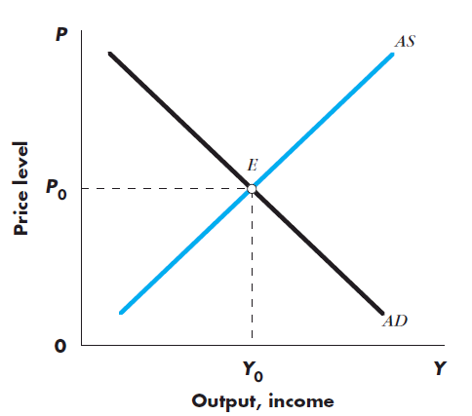
AS, AD, and Equilibrium
AS and AD intersect at point E in Figure 5-1
→ Equilibrium: AS = AD
Equilibrium output is Y₀
Observed level of output in the economy at particular point in time
Equilibrium price level is P₀
Observed price level in the economy at particular point in time

Slide 5
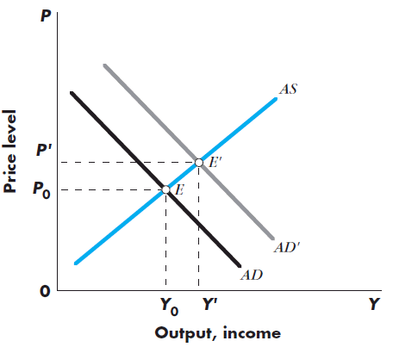
AS, AD, and Equilibrium
Shifts in either the AS or AD schedule result in a change in the equilibrium level of prices and output
Increase in AD → increase in P and Y
Decrease in AD → decrease in P and Y
Increase in AS → decrease in P and increase in Y
Decrease in AS → increase in P and decrease in Y
Figure 5-2 illustrates an increase in AD resulting from an increase in money supply

Slide 6
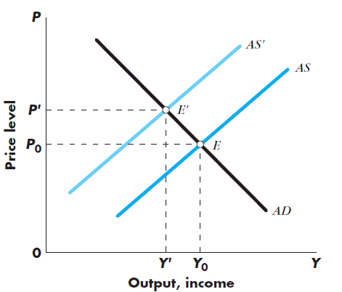
AS, AD, and Equilibrium
→ The amount of the increase/decrease in P and Y after a shift in either aggregate supply or aggregate demand depends on:
The slope of the AS curve
The slope of the AD curve
The extent of the shift of AS/AD
Figure 5-3 shows the result of an adverse AS shock: ↓AS → ↓Y, ↑P

Slide 7
Figure 5-2 shows that an increase in the money supply shifts the aggregate demand curve, AD, to the right, to AD'.

Slide 8
The shift of the aggregate demand curve moves the equilibrium of the economy from E to E’. The price level rises from P₀ to P’, and the level of output from Y₀ to Y’ .
Thus an increase in the money stock causes both the level of output and the price level to rise.
It is clear from Figure 5-2 that the amount by which the price level rises depends on the slope of the aggregate supply curve as well as the extent to which the aggregate demand curve shifts and its slope.
Much of the text is devoted to exploring the slope of the aggregate supply curve and the causes of shifts in the aggregate demand curve.

Slide 9
Figure 5-3 shows the results of an adverse (upward and leftward) aggregate supply shock (the 1973 OPEC oil embargo is a classic example of such a shock). The leftward shift of the aggregate supply curve cuts output and raises prices.
Figure 5-3 shows the result of an adverse AS shock: ↓AS → ↓Y, ↑P

Slide 10
The amount of the increase/decrease in P and Y after a shift in either aggregate supply or aggregate demand depends on:
1. The slope of the AS curve
2. The slope of the AD curve
3. The extent of the shift of AS/AD

Slide 11
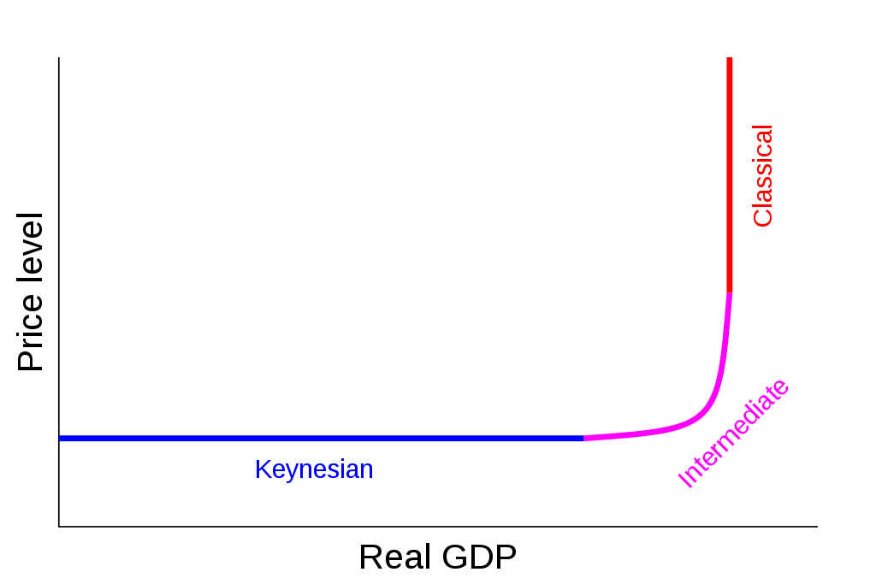
Aggregate supply curve showing the three ranges: Keynesian, Intermediate, and Classical. In the Classical range, the economy is producing at full employment.

Slide 12
There are generally three alternative degrees of price-level responsiveness of aggregate supply. They are:
Short-run aggregate supply (SRAS) — During the short-run, firms possess one fixed factor of production (usually capital), and some factor input prices are sticky. The quantity of aggregate output supplied is highly sensitive to the price level, as seen in the flat region of the curve in the above diagram.

Slide 13
Long-run aggregate supply (LRAS) — Over the long run, only capital, labour, and technology affect the LRAS in the macroeconomic model because at this point everything in the economy is assumed to be used optimally. In most situations, the LRAS is viewed as static because it shifts the slowest of the three. The LRAS is shown as perfectly vertical, reflecting economists' belief that changes in aggregate demand (AD) have an only temporary change on the economy's total output.

Slide 14
Medium run aggregate supply (MRAS) — As an interim between SRAS and LRAS, the MRAS form slopes upward and reflects when capital, as well as labor usage, can change. More specifically, medium run aggregate supply is like this for three theoretical reasons, namely the Sticky-Wage Theory, the Sticky-Price Theory and the Misperception Theory. The position of the MRAS curve is affected by capital, labour, technology, and wage rate.

Slide 15
There are two main reasons why the amount of aggregate output supplied might rise as price level P rises, i.e., why the AS curve is upward sloping:
1. The short-run AS curve is drawn given some nominal variables such as the nominal wage rate, which is assumed fixed in the short run. Thus, a higher price level P implies a lower real wage rate and thus an incentive to produce more output. In the neoclassical long run, on the other hand, the nominal wage rate varies with economic conditions. (High unemployment leads to falling nominal wages which restore full employment.) Hence, in the long run, the aggregate supply curve is vertical.

Slide 16
2. An alternative model starts with the notion that any economy involves a large number of heterogeneous types of inputs, including both fixed capital equipment and labor. Both main types of inputs can be unemployed. The upward-sloping AS curve arises because (1) some nominal input prices are fixed in the short run and (2) as output rises, more and more production processes encounter bottlenecks. At low levels of demand, there are large numbers of production processes that do not use their fixed capital equipment fully. Thus, production can be increased without much in the way of diminishing returns and the average price level need not rise much (if at all) to justify increased production. The AS curve is flat. On the other hand, when demand is high, few production processes have unemployed fixed inputs. Thus, bottlenecks are general. Any increase in demand and production induces increases in prices. Thus, the AS curve is steep or vertical.

Slide 17
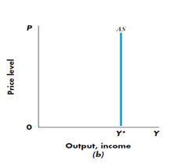
Classical Supply Curve
The aggregate supply curve describes, for each given price level, the quantity of output firms are willing to supply. In the short run the AS curve is horizontal (the Keynesian aggregate supply curve); in the long run the AS curve is vertical (the classical aggregate supply curve).
The classical supply curve is vertical, indicating that the same amount of goods will be supplied, regardless of price [Figure 5-4 (b)]
Based upon the assumption that the labor market is in equilibrium with full employment of the labor force
The level of output corresponding to full employment of the labor force = potential GDP, Y*

Slide 18
THE CLASSICAL SUPPLY CURVE
The classical aggregate supply curve is vertical, indicating that the same amount of goods will be supplied whatever the price level. The classical supply curve is based on the assumption that the labor market is in equilibrium with full employment of the labor force.
If the idea that the aggregate supply curve is vertical in the long run makes you uncomfortable, remember that the term “price level” here means overall prices. In a single market, manufacturers faced with high demand can raise the price for their products and go out and buy more materials, more labor, and so forth. This has the side effect of shifting factors of production away from lower demand sectors and into this particular market. But if high demand is economywide and all the factors of production are already at work, there isn’t any way to increase overall production, and all that happens is that all prices increase (wages too, of course).

Slide 19
It is important to note that while potential GDP changes each year, the changes do not depend on the price level.
We say that potential GDP is “exogenous with respect to the price level”; what’s more, changes in potential GDP over a short period are usually relatively small, a few percent a year.
We can draw a single vertical line at potential GDP and call it “long-run aggregate supply” without needing to worry much about the rightward movement due to potential GDP growth.

Slide 20
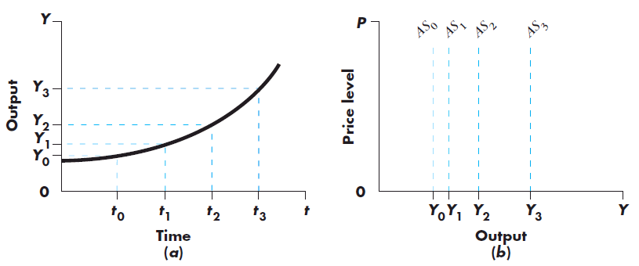
We call the level of output corresponding to full employment of the labor force potential GDP, Y*. Potential GDP grows over time as the economy accumulates resources and as technology improves, so the position of the classical aggregate supply curve moves to the right over time, as shown in Figure 4.

Slide 21
It is important to note that while potential GDP changes each year, the changes do not depend on the price level. We say that potential GDP is “exogenous with respect to the price level”; what’s more, changes in potential GDP over a short period are usually relatively small, a few percent a year. We can draw a single vertical line at potential GDP and call it “long-run aggregate supply” without needing to worry much about the rightward movement due to potential GDP growth.

Slide 22
KEYNESIAN AGGREGATE SUPPLY CURVE
The Keynesian aggregate supply curve is horizontal, indicating that firms will supply whatever amount of goods is demanded at the existing price level.
The idea underlying the Keynesian aggregate supply curve is that because there is unemployment, firms can obtain as much labor as they want at the current wage. Their average costs of production therefore are assumed not to change as their output levels change. They are accordingly willing to supply as much as is demanded at the existing price level.

Slide 23
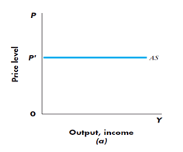
KEYNESIAN AGGREGATE SUPPLY CURVE

Slide 24
The intellectual genesis of the Keynesian aggregate supply curve lay in the Great Depression, when it seemed that output could expand endlessly without increasing prices by putting idle capital and labor to work.
Today, we’ve overlaid this notion with what we call “short-run price stickiness.” In the short run, firms are reluctant to change prices (and wages) when demand shifts. Instead, at least for a little while, they increase or decrease output.
As a result, the aggregate supply curve is quite flat in the short run.

Slide 25
It is important to note that on a Keynesian aggregate supply curve, the price level does not depend on GDP. In most countries prices rise in most years; in other words, there is some ongoing, though perhaps small, inflation. For reasons we explore later, this price increase is associated with an upward shift of the aggregate supply curve—not a move along the curve. For the moment, we assume that we are in an economy with no expected inflation. The key point is that in the short run the price level is unaffected by current levels of GDP.

Slide 26
Frictional Unemployment and the Natural Rate of Unemployment
Taken literally, the classical model implies that there is no involuntary unemployment → everyone who wants to work is employed
In reality there is some unemployment due to frictions in the labor market (Ex. Someone is always moving and looking for a new job)
The unemployment rate associated with the full employment level of output is the natural rate of unemployment
Natural rate of unemployment is the rate of unemployment arising from normal labor market frictions that exist when the labor market is in equilibrium

Slide 27
Frictional unemployment is a type of unemployment. It is sometimes called search unemployment and can be based on the circumstances of the individual. It is time spent between jobs when a worker is searching for a job or transferring from one job to another.
Frictional unemployment is one of the three broad categories of unemployment, the others being structural unemployment and cyclical unemployment. A person may be looking for a job change for better opportunities, services, salary and wages, or because of dissatisfaction with the previous job.

Slide 28
The natural rate of unemployment, when an economy is in a steady state of "full employment", is the proportion of the workforce who are unemployed'.
Put another way, this concept clarifies that the economic term "full employment" does not mean "zero unemployment". It represents the hypothetical unemployment rate consistent with aggregate production being at the "long-run" level.

Slide 29
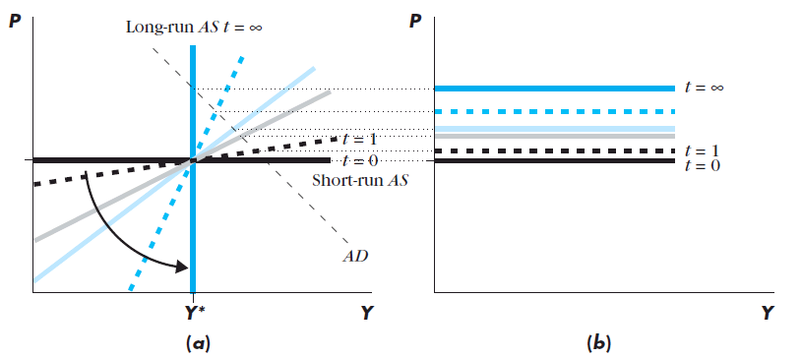
AS and the Price Adjustment Mechanism
AS curve describes the price adjustment mechanism within the economy
Figure 5-6 shows the SRAS curve in black and the LRAS in blue, and the adjustment from the SR to the LR. Think of the aggregate supply curve as rotating, counterclockwise, from horizontal to vertical with the passage of time.
The AS curve is defined by the equation: (1) where
P_{t-1} is the price level next period
P_{t} is the price level today
Y* is potential output

Slide 30
The aggregate supply curve that applies at, say, a 1-year horizon is a black dashed line and medium-sloped. If aggregate demand is greater than potential output, Y * , then this intermediate curve indicates that after a year’s time prices will have risen enough to partially, but not completely, push GDP back down to potential output.
Figure 5-6 a gives a useful, but static, picture of what is really a dynamic process. We focus on the aggregate supply curve as a description of the mechanism by which prices rise or fall over time. Equation (1) gives the aggregate supply curve:

Slide 31
AS and the Price Adjustment Mechanism
(1)
If output is above potential (Y>Y*), prices increase, higher next period
If output is below potential (Y<Y*), prices fall, lower next period
Prices continue to rise/fall over time until Y=Y*
Today’s price equals tomorrow’s if output equals potential (ignoring price expectations)
The difference between GDP and potential GDP, Y-Y*, is called the output gap

Slide 32
AS and the Price Adjustment Mechanism
(1)
Upward shifting horizontal lines in Figure 5-6 (b) correspond to successive snapshots of equation (1)
Beginning with the horizontal black line at time t=0, at Y>Y*, price higher (AS shifting up) by t=1
Process continues until Y=Y*

Slide 33
AS and the Price Adjustment Mechanism
(1)
Speed of the price adjustment mechanism controlled by the parameter λ
If λ is large, AS moves quickly (the counter clock-wise rotations in Figure 5-6 (a))
If λ is small, prices adjust slowly
λ is of importance to policy makers:
If λ is large, the AS mechanism will return the economy to Y* relatively quickly
If λ is small, might want to use AD policy to speed up the adjustment process

Slide 34
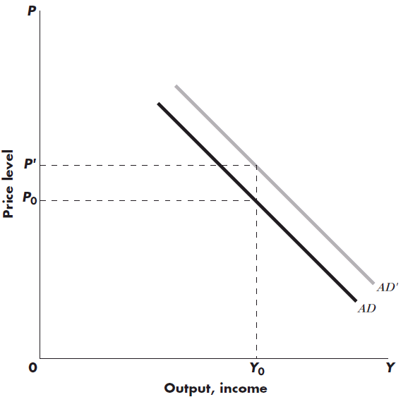
AD Curve and Shifts in AD
AD shows the combination of the price level and level of output at which the goods and money markets are simultaneously in equilibrium
Shifts in AD due to:
Policy measures (changes in G, T, and Money Supply)
Consumer and investor confidence
Figure 5-8 shows an outward shift in AD resulting from an increase in the money supply

Slide 35
AD Relationship Between Output and Prices
Key to the AD relationship between output and prices is the dependency of AD on real money supply
Real money supply = value of money provided by the central bank and the banking system
Real money supply is written as , where is the nominal money supply, and P is the price level
AND
For a given level of , high prices result in low OR high prices mean that the value of the number of available dollars is low and thus a high P = low level of AD

Slide 36
The aggregate demand curve represents equilibrium in both the goods and money markets. Expansion from the goods markets—say, from increased consumer confidence or expansionary fiscal policy—moves the aggregate demand schedule up and to the right. Expansionary monetary policy similarly moves aggregate demand up and to the right.

Slide 37
AD and the Money Market
For the moment, ignore the goods market and focus on the money market and the determination of AD
The quantity theory of money offers a simple explanation of the link between the money market and AD
The total number of dollars spent in a year, NGDP, is P*Y
The total number of times the average dollar changes hands in a year is the velocity of money, V
The central bank provides M dollars
→ The fundamental equation underlying the quantity theory of money is the quantity equation: (2)

Slide 38
AD and the Money Market
(2)
If the velocity of money is assumed constant, equation (2) becomes , and is an equation for the AD curve
For a given level of M, an increase in Y must be offset by a decrease in P, and vice versa
Inverse relationship between Y and P as illustrated by downward sloping AD curve
An increase in M shifts the AD curve upward for any value of Y

Slide 39
Changes in the Money Stock and AD
An increase in the nominal money stock shifts the AD schedule up in proportion to the increase in nominal money
Suppose corresponds to AD and the economy is operating at P₀ and Y₀
If money stock increases by 10% to , AD shifts to AD’ → the value of P corresponding to Y₀ must be P’ = 1.1P₀
Therefore → real
money balances and Y are unchanged

Slide 40
AGGREGATE DEMAND POLICY UNDER ALTERNATIVE SUPPLY ASSUMPTIONS
Now we use the aggregate demand and supply model to study the effects of aggregate demand policy in the two extreme supply cases—Keynesian and classical.
THE KEYNESIAN CASE
In Figure 5.9 we combine the aggregate demand schedule with the Keynesian aggregate supply schedule. The initial equilibrium is at point E, where AS and AD intersect. At that point the goods and assets markets are in equilibrium.

Slide 41
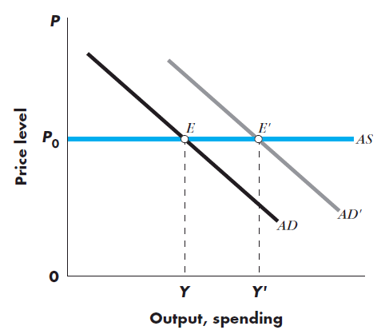
AD Policy & the Keynesian Supply Curve
Figure 5-9 shows the AD schedule and the Keynesian supply schedule
Initial equilibrium is at point E (AS = AD)
Suppose an aggregate demand policy increases AD to AD’
The new equilibrium point, E’, corresponds to the same price level, and a higher level of output (employment is also likely to increase)

Slide 42
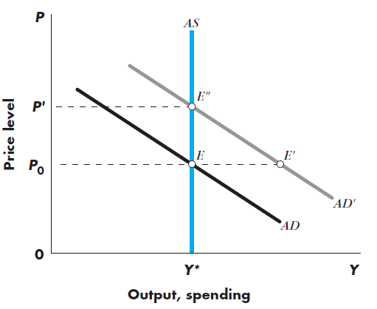
AD Policy & the Classical Supply Curve
In the classical case, AS schedule is vertical at FE level of output
Unlike the Keynesian case, the price level is not given, but depends upon the interaction between AS and AD
Suppose AD increases to AD’
Spending increases to E’ BUT firms can not obtain the N required to meet the increased demand
Firms hire more workers & wages and costs of production rise → firms must charge higher price
Move up AS and AD curves to E’’ where AS = AD’

Slide 43
AD Policy & the Classical Supply Curve
The increase in price from the increase in AD reduces the real money stock, , and
leads to a reduction in spending
The economy only moves up AD until prices have risen enough, and M/P has fallen enough, to reduce total spending to a level consistent with full employment
→ this is true at E’’, where AD’ = AS

Slide 44
IN SHORT:
The expansion shifts the aggregate demand schedule from AD to AD’. At the initial level of prices, Po, spending in the economy would rise to point E’. At price level Po, the demand for goods has risen. But firms cannot obtain the labor to produce more output, and output supply cannot respond to the increased demand.
As firms try to hire more workers, they bid up wages and their costs of production, so they must charge higher prices for their output. The increase in the demand for goods therefore leads only to higher prices, and not to higher output.
The increase in prices reduces the real money stock and leads to a reduction in spending. The economy moves up the schedule until prices have risen enough, and the real money stock has fallen enough, to reduce spending to a level consistent with full-employment output. That is the case at price level P’. At point E’’ aggregate demand, at the higher level of government spending, is once again equal to aggregate supply.

Slide 45
Supply Side Economics
Supply side economics focuses on AS as the driver in the economy
Supply side policies are those that encourage growth in potential output → shift AS to right
Such policy measures include:
Removing unnecessary regulation
Maintaining efficient legal system
Encouraging technological progress
Politicians use the term supply side economics in reference to the idea that cutting taxes will increase AS enough that tax collections will actually increase, rather than fall

Slide 46
Supply-side economics is a macroeconomic theory arguing that economic growth can be most effectively created by lowering taxes and decreasing regulation,by which it is directly opposed to demand-side economics. According to supply-side economics, consumers will then benefit from a greater supply of goods and services at lower prices and employment will increase.
The Laffer curve, a theoretical relationship between rates of taxation and government revenue which suggests that lower tax rates when the tax level is too high will actually boost government revenue because of higher economic growth, is one of the main theoretical constructs of supply-side economics.

Slide 47
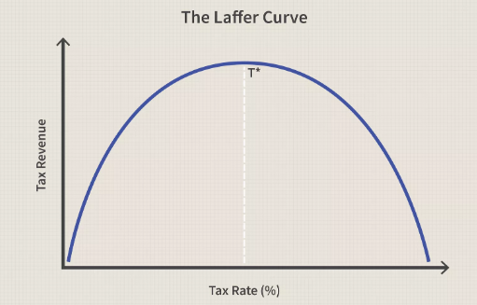
What is the Laffer Curve?
The Laffer Curve is a theory developed by supply-side economist Arthur Laffer to show the relationship between tax rates and the amount of tax revenue collected by governments. The curve is used to illustrate Laffer’s argument that sometimes cutting tax rates can increase total tax revenue.

Slide 48
At a 0% tax rate, tax revenue would obviously be zero. As tax rates increase from low levels, tax revenue collected by the also government increases. Eventually, if tax rates reached 100 percent, shown as the far right on the Laffer Curve, all people would choose not to work because everything they earned would go to the government.
Therefore it is necessarily true that at some point in the range where tax revenue is positive, it must reach a maximum point. This is represented by T* on the graph below. To the left of T* an increase in tax rate raises more revenue than is lost to offsetting worker and investor behavior. Increasing rates beyond T* however would cause people not to work as much or not at all, thereby reducing total tax revenue.

Slide 49
Therefore at any tax rate to the right of T*, a reduction in tax rate will actually increase total revenue. The shape of the Laffer Curve, and thus the location of T* is dependent on worker and investor preferences for work, leisure, and income, as well as technology and other economic factors.
Governments would like to be at point T* because it is the point at which the government collects maximum amount of tax revenue while people continue to work hard. If the current tax rate is to the right of T*, then lowering the tax rate will both stimulate economic growth by increasing incentives to work and invest, and increase government revenue because more work and investment means a larger tax base.

Slide 50
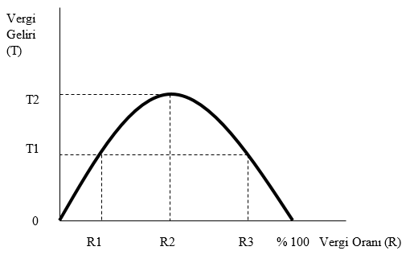
Laffer Eğrisi’nin ortaya koymaya çalıştığı şey şudur: Vergi oranı sıfır olduğunda vergi toplanmayacak, oran yüzde 100 olduğunda ise bütün kazancını vergi olarak verecek olan kişiler üretim yapmayacak dolayısıyla vergi doğmayacak emektir. Vergi oranının R1’den R2’ye artırıldığını varsayalım. Bu durumda vergi gelirleri T1’den T2’ye yükselmektedir. Vergi oranının R2’den R3’e artırıldığını varsayalım. Bu durumda kişiler elde ettikleri gelirin çoğunu vergi olarak ödeyeceklerini gördükleri için çalışma saatlerini azaltacaklar ve vergi tahsilâtı artmayacak, tam tersine T2’den T1’e gerileyecektir. Dolayısıyla bu teze göre aşırı yüksek olan vergi oranlarında yapılacak indirimler, bir yandan insanların daha fazla çalışmasını teşvik ederken bir yandan da vergi kaçırma arzularının düşmesine yol açacak ve vergi tahsilâtını azaltmak bir yana artıracaktır.

Slide 51
Arz yönlü ekonominin özellikle vergiyle ilgili önermeleri ABD’de Reagan, İngiltere’de Thatcher ve Türkiye’de Özal zamanında uygulanmış, fakat iddia edildiği gibi vergi oranı indirimleri vergi tahsilâtını artırmamıştır. Hatta Türkiye’deki uygulamada 1980’erin ortasında gelir vergisi oranlarında iki yıl üst üste yapılan indirimlerin gelir vergisi gelirlerini artırması bir yana, düşen vergi gelirleri miktarının eski düzeyine gelmesi 14 yıl sürmüştür. Bunun nedenleri üzerine yapılan çalışmalar vergi oranlarının Laffer’in iddia ettiği kadar yüksek olmadığı ya da durumun bir çan eğrisi ile temsil edilmesinin yanlış olduğu yolunda sonuçlara ulaşmıştır.
Arz yönlü ekonominin vergi oranlarının düşürülmesi önerisi; bütçe açıklarının artmasına ve kamu borçlanmasının yükselmesine, çevre önlemlerinin azaltılması önerisi; çevrenin daha çok tahrip olmasına, deregülasyona gidilmesi önerisi; kuralların zayıflatılmasına ve bunun sonucunda etik dışı kazanç yollarına sapılmasına kaynaklık etmiştir. Özetle söylemek gerekirse küresel krize giden yolda arz yönlü ekonomi yaklaşımının olumsuz katkıları olmuştur.

Slide 52
Supply Side Economics
All economists are in favor of policies that move the aggregate supply curve to the right by increasing potential GDP. Such supply-side policies as removing unnecessary regulation, maintaining an efficient legal system, and encouraging technological progress are all desirable, although not always easy to implement.
However, there is a group of politicians who use the term “supply-side economics” in reference to the idea that cutting tax rates will increase aggregate supply enormously—so much, in fact, that tax collections will rise, rather than fall.

Slide 53
Cutting tax rates has effects on both aggregate supply and aggregate demand. The aggregate demand curve shifts right from AD to AD’. The shift is relatively large. The aggregate supply curve also shifts to the right, from AS to AS’ , because lower tax rates increase the incentive to work. However, economists have known for a very long time that the effect of such an incentive is quite small, so the rightward shift of potential GDP is small. The large shift in aggregate demand and small shift in aggregate supply are illustrated in Figure 5-11 .

Slide 54
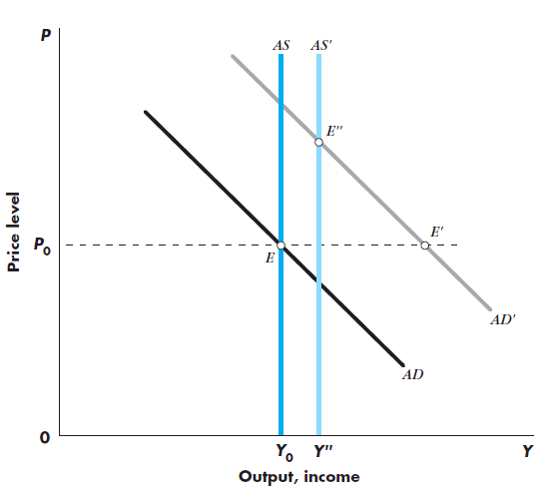
Supply Side Economics
Cutting tax rates has an impact on both AS and AD
AD shifts to AD’ due to increase in disposable income
Shift is relatively large compared to that of the AS
AS shifts to AS’ as the incentive to work increases
In short run, move to E’: GDP increases, tax revenues fall proportionately less than tax cut (AD effect)
In the LR, moves to E’’: GDP is higher, but by a small amount, tax collections fall as the deficit rises, and prices rise (AS effect)

Slide 55
Supply Side Economics
Supply side policies are useful, despite previous example
Only supply side policies can permanently increase output
Demand side policies are useful for short run results
Many economists support cutting taxes for the incentive effect, but with a simultaneous reduction in government spending
Tax collections fall, but the reduction in government spending minimizes the impact on the deficit

