Slide 1
ECON 575 FUNDAMENTALS OF ECONOMICS CHAPTER 2 DEMAND AND SUPPLY Prof. Dr. Dilek Temiz Dinç

Slide 2
Demand
The law of demand states that the quantity of a good demanded is inversely related to the good’s price
In other words, other things equal,
Quantity demanded rises as price falls
Quantity demanded falls as price rises
As prices change, people change how much they’re willing to buy
The law of demand is based on the fact that when prices for a good rise, people substitute away from that good to other goods

Slide 3
The Demand Curve
A demand curve is the graphic representation of the relationship between price and quantity demanded
P
The demand curve is downward sloping
P₁
As price increases, quantity demanded decreases
P₀
Demand
Q
Q₁
Q₀

Slide 4
Shifts in Demand versus Movements Along a Demand Curve
Quantity demanded refers to a specific amount that will be demanded per unit of time at a specific price, other things constant
Refers to a specific point on the demand curve
A change in price causes a change in quantity demanded
A change in price causes a movement along the demand curve

Slide 5
Quantity demanded is the amount of a good, service, or resource that people are willing and able to buy during a specified period at a specified price.
The quantity demanded is an amount per unit of time. For example, the amount per day or per month.

Slide 6
Shifts in Demand versus Movements Along a Demand Curve
Demand refers to a schedule of quantities of a good that will be bought per unit of time at various prices, other things constant
Refers to the entire demand curve
Demand tells us how much will be bought at various prices
A change in anything other than price that affects the demand curve changes the entire demand curve
A change in the entire demand curve is a shift in demand

Slide 7
Demand schedule is a list of the quantities demanded at each different price when all the other influences on buying plans remain the same.
Demand curve is a graph of the relationship between the quantity demanded of a good and its price when all other influences on buying plans remain the same.

Slide 8
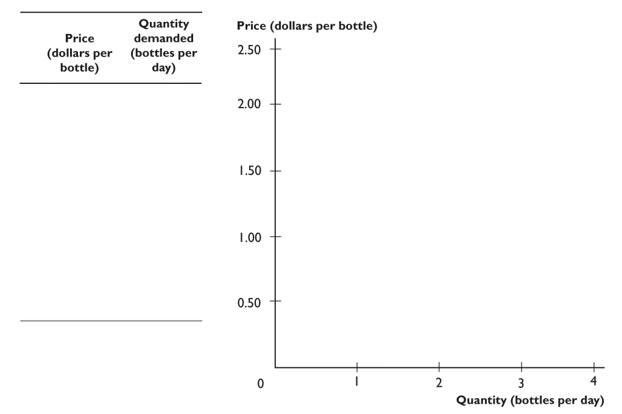
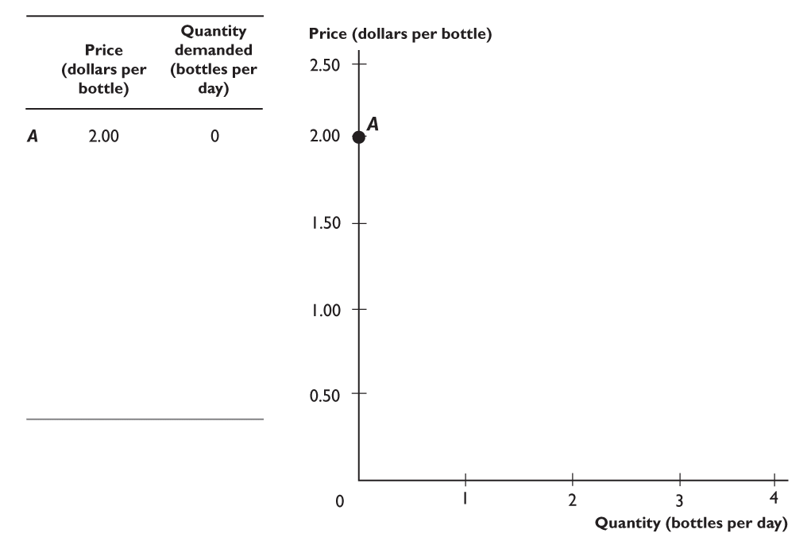
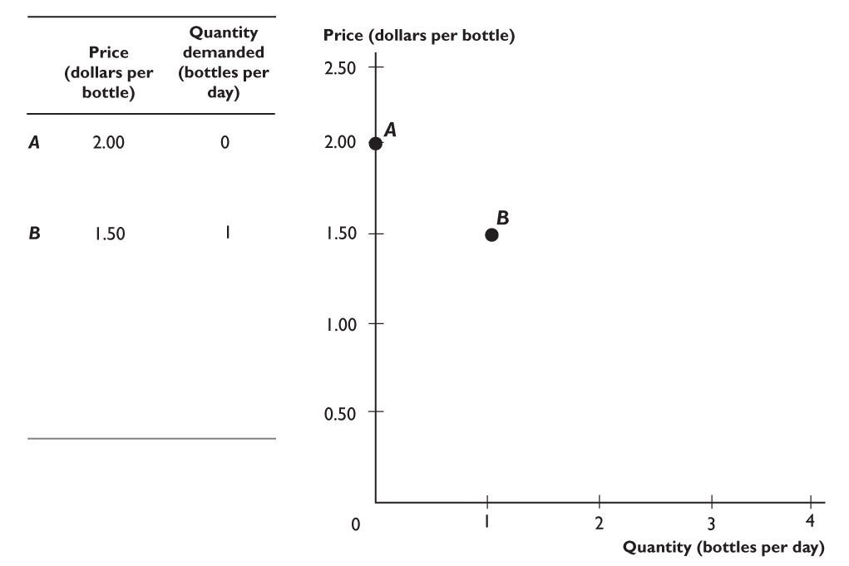
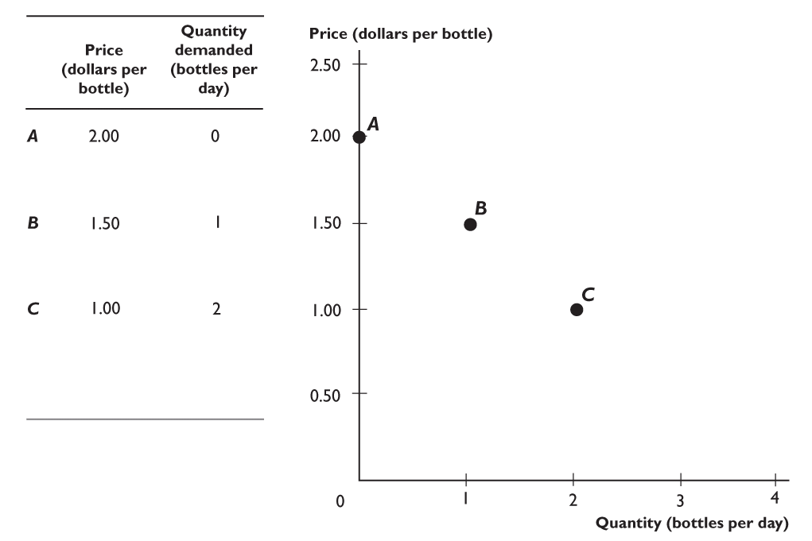
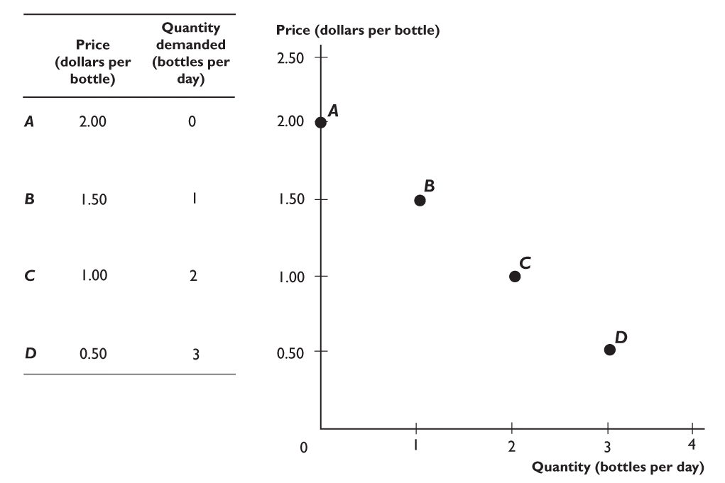
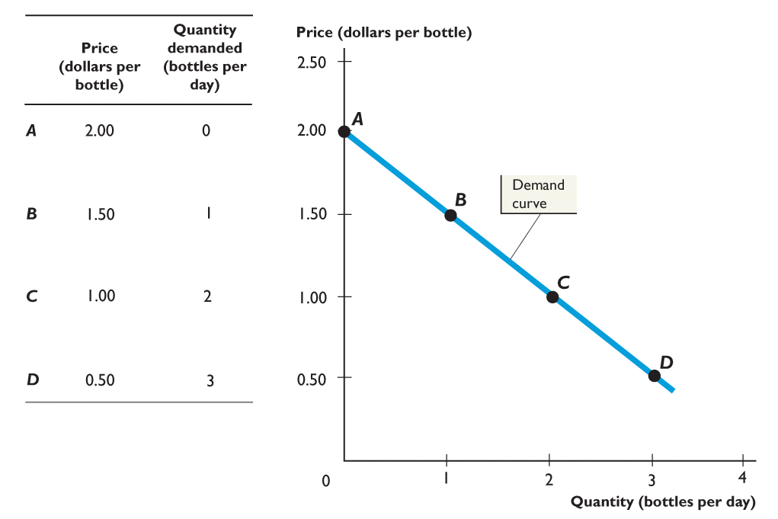

Slide 9
Shifts in Demand versus Movements Along a Demand Curve
P
Movement along a demand curve
A change in price causes a movement along the demand curve
B
$2
$1
A
Demand
Q
100
200

Slide 10
Shifts in Demand versus Movements Along a Demand Curve
P
Shift in demand
A change in a shift factor causes a shift in demand
B
A
$1
Demand₀
Demand₁
Q
175
200

Slide 11
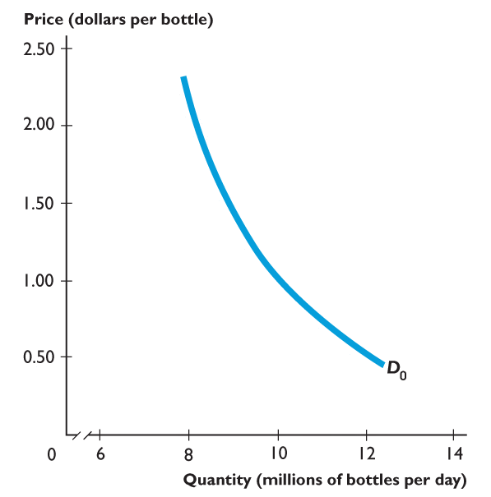
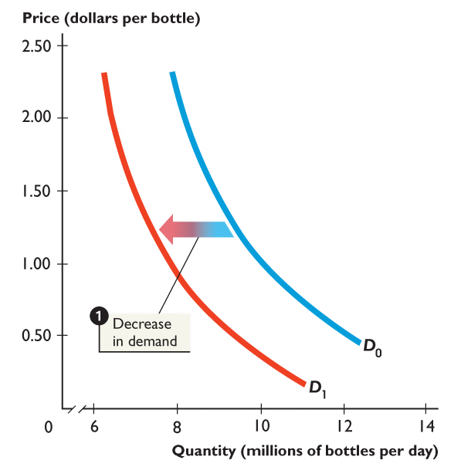
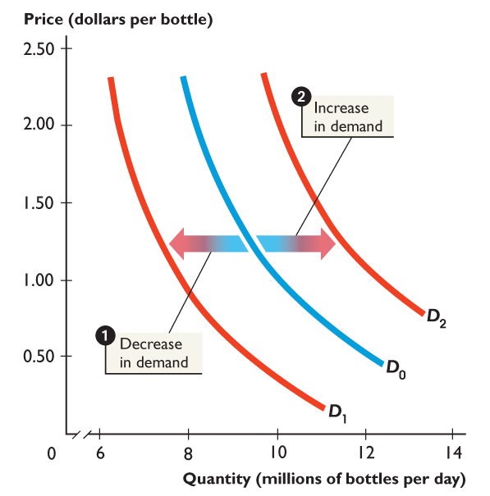
Figure 2 shows
changes in demand.
1. When demand decreases, the demand curve shifts leftward from D₀ to D₁.
2. When demand increases, the demand curve shifts rightward from D₀ to D₂.

Slide 12
Shift Factors in Demand
Important demand shift factors include:
Society’s (consumer’s or household’s) income
The prices of other related goods
Tastes
Population and demographics
Expectations
Taxes and subsidies

Slide 13
What factors influence market demand?
Income of consumers
Increase in income increases demand if product is normal, decreases demand if product is inferior.
Prices of related goods
Increase in price of related good increases demand if products are substitutes, decreases demand if products are complements
Tastes
Population and demographics
Expected future prices
We will discuss how each of these affects demand.

Slide 14
Change in income of consumers
Normal goods: Goods for which the demand increases as income rises, and decreases as income falls.
Examples: Clothing
Restaurant meals
Vacations
Inferior goods: Goods for which the demand decreases as income rises, and increases as income falls.
Examples: Second-hand clothing
Urban mass transit (buss ride)
Effect of increase in income, if good is normal
Effect of increase in income, if good is inferior

Slide 15
Change in the price of related goods
Substitutes: Goods and services that can be used for the same purpose.
Examples: Big Mac and Whopper
Ford F-150 and Dodge Ram
Complements: Goods and services that are consumed together.
Examples: Big Mac and cola
tea and sugar
Left shoes and right shoes
Effect on demand for Big Macs, if price of Whopper increases
Effect on demand for Big Macs, if price of McDonald’s fries increases

Slide 16
Change in tastes or population/demographics
Tastes
If consumers’ tastes change, they may buy more or less of the product.
Example: If consumers become more concerned about eating healthily, they might decrease their demand for fast food.
Population and demographics
Increases in the number of people buying something will increase the amount demanded.
Example: An increase in the elderly population increases the demand for medical care.
Effect on demand for fast food, if consumers want to eat healthy
Effect on demand for medical care, as the population ages

Slide 17
Change in expectations about future prices
Consumers decide which products to buy and when to buy them.
Future products are substitutes for current products
An expected increase in the price tomorrow increases demand today.
An expected decrease in the price tomorrow decreases demand today.
Example: If you found out the price of gasoline would go up tomorrow, you would increase your demand today.
Effect on today’s gasoline demand, if price will rise tomorrow

Slide 18
Taxes and Subsidies
Taxes levied on consumers increase the cost of goods to consumers and therefore reduce demand for those goods.
Subsidies to consumers have the opposite effect.
Example:
When states host tax-free weeks during August's back-to-school shopping season, consumers load up on products to avoid sales taxes. Demand for retail goods rises during the tax holiday.
Effect of subsidies on demand

Slide 19
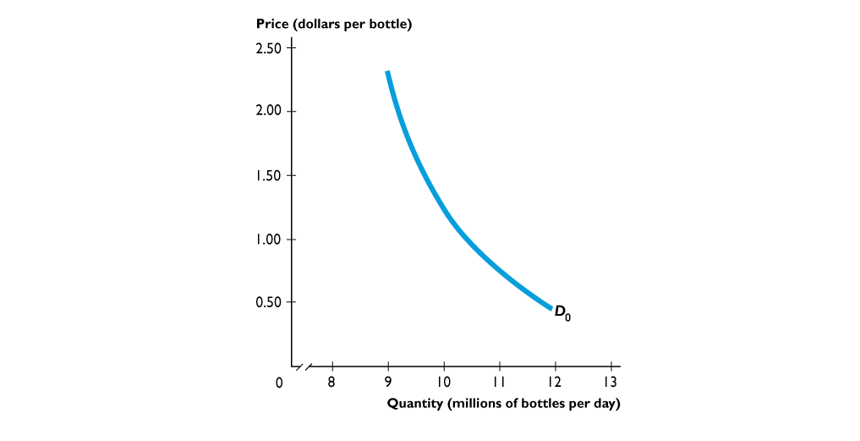
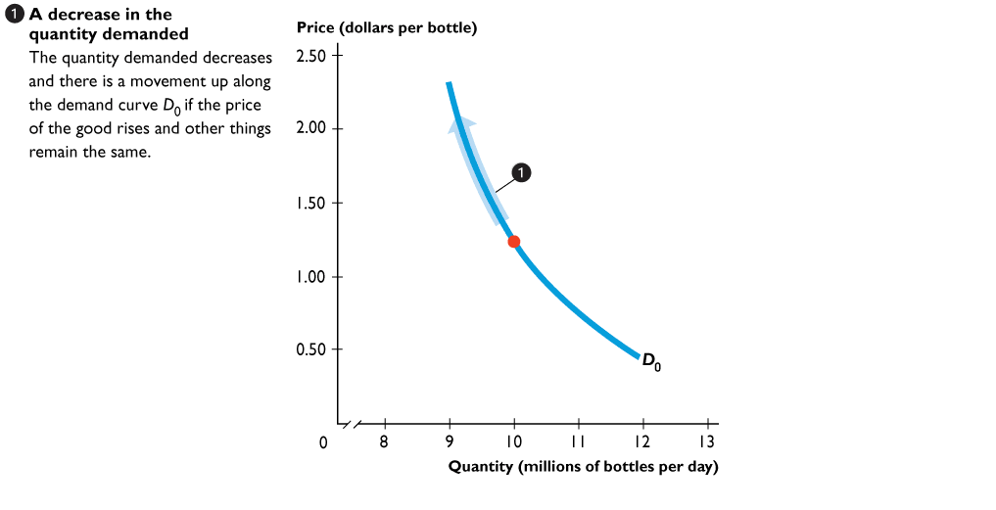
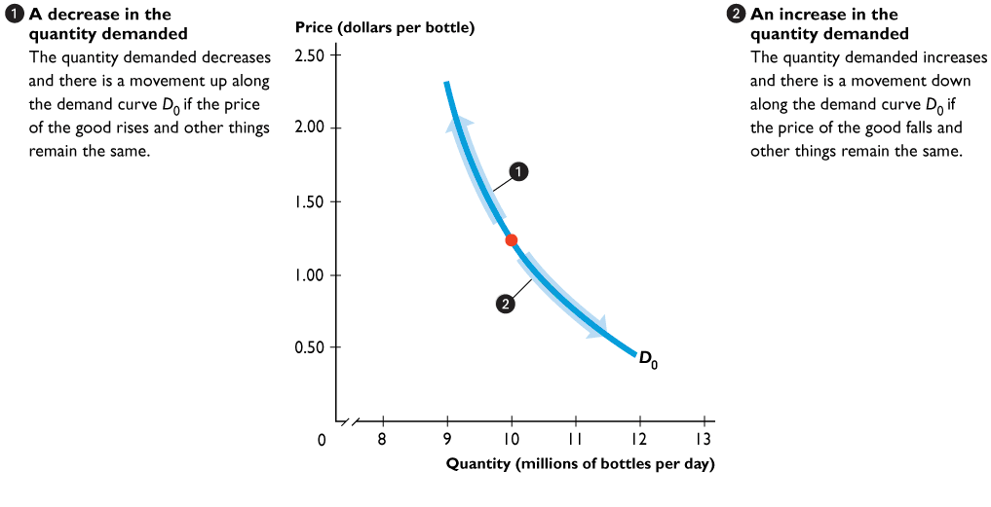
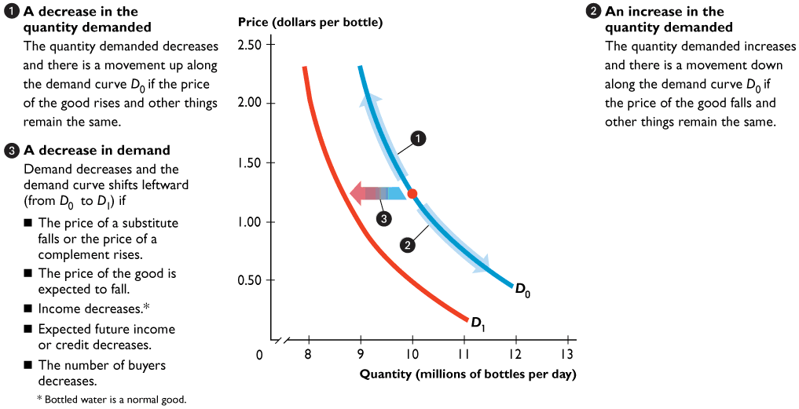
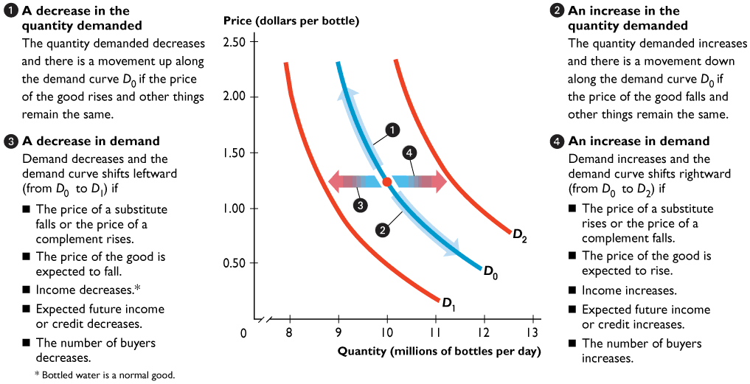

Slide 20
Application: Demand Shift
What happens to demand for CDs if you won $1 million in the lottery?
P
Demand would shift out to the right because your income increased
Demand₁
Demand₀
Q

Slide 21
From a Demand Table to a Demand Curve
P
 | Price per movie | Movie rentals demanded per week
A | $1.00 | 9
B | $2.00 | 8
C | $4.00 | 6
D | $6.00 | 4
E | $8.00 | 2
E
$8.00
D
Demand for movies
$6.00
$4.00
C
$2.00
B
A
$1.00
Q
2
4
6
8
10

Slide 22
Individual and Market Demand Curves
Price (per movie) | Alice’s demand | + Bruce’s demand | + Carmen’s demand | = Market demand
$2.00 | 8 | 5 | 1 | 14
$4.00 | 6 | 3 | 0 | 9
$6.00 | 4 | 1 | 0 | 5
$8.00 | 2 | 0 | 0 | 2

Slide 23
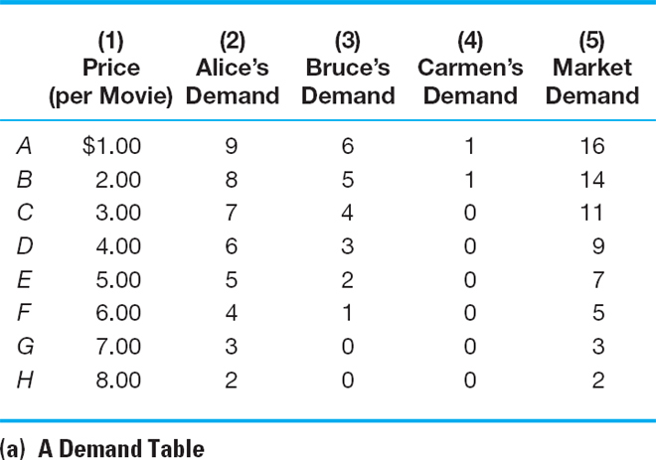
Individual and Market Demand Curves

Slide 24
Individual and Market Demand Curves
Market demand curve for movies per week
P
The market demand curve is the horizontal sum of all individual demand curves
$8.00
$6.00
$4.00
Market demand for movies
$2.00
CARMEN
BRUCE
ALICE
Q
4
6
7
8
9
13
14
15
16
1
2
5
10
11
12
3

Slide 25
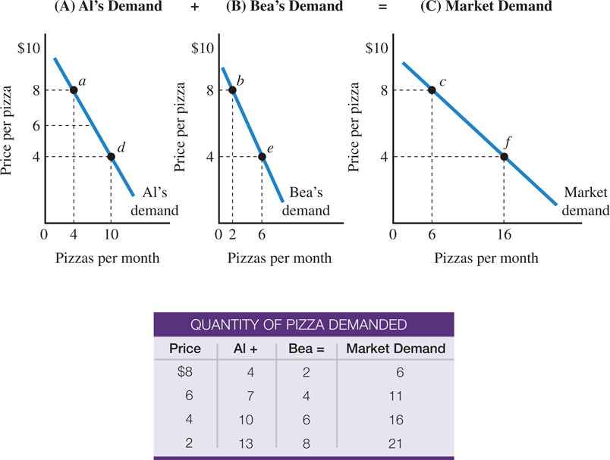
From Individual Demand to Market Demand
The market demand equals the sum of the demands of all consumers. In this case, there are only two, so at each price the market quantity demanded equals the quantity demanded by Al plus the quantity demanded by Bea.
At a price of $8, Al’s quantity is four pizzas (point a) and Bea’s quantity is two pizzas (point b), so the market quantity demanded is six pizzas (point c).
Each consumer obeys the law of demand, so the market demand curve is negatively sloped.
● market demand curve A curve showing the relationship between price and quantity demanded by all consumers, ceteris paribus.

Slide 26
Six Things to Remember about a Demand Curve
A demand curve follows the law of demand: When price rises, quantity demanded falls, and vice versa.
The horizontal axis—quantity—has a time dimension.
The quality of each unit is the same.
The vertical axis—price—assumes all other prices remain the same.
The demand curve assumes everything else is held constant.
Effects of price changes are shown by movements along the demand curve. Effects of anything else on demand (shift factors) are shown by shifts of the entire demand curve.

Slide 27
Supply
The law of supply states that the quantity of a good supplied is directly related to the good’s price
In other words, other things equal,
Quantity supplied rises as price rises
Quantity supplied falls as price falls
The law of supply occurs because:
When prices rise, firms substitute production of one good for another
Assuming firm’s costs are constant, a higher price means higher profit

Slide 28
The Supply Curve
A supply curve is the graphic representation of the relationship between price and quantity supplied
P
Supply
The supply curve is upward sloping
P₁
As price increases, quantity supplied increases
P₀
Q
Q₀
Q₁

Slide 29
Shifts in Supply versus Movements Along a Supply Curve
Quantity supplied refers to a specific amount that will be supplied per unit of time at a specific price, other things constant
Refers to a specific point on the supply curve
A change in price changes quantity supplied
A change in price causes a change in quantity supplied
A change in price causes a movement along the supply curve

Slide 30
A supply schedule is a list of the quantities supplied at each different price when all other influences on selling plans remain the same.
A supply curve is a graph of the relationship between the quantity supplied and the price of the good when all other influences on selling plans remain the same.

Slide 31
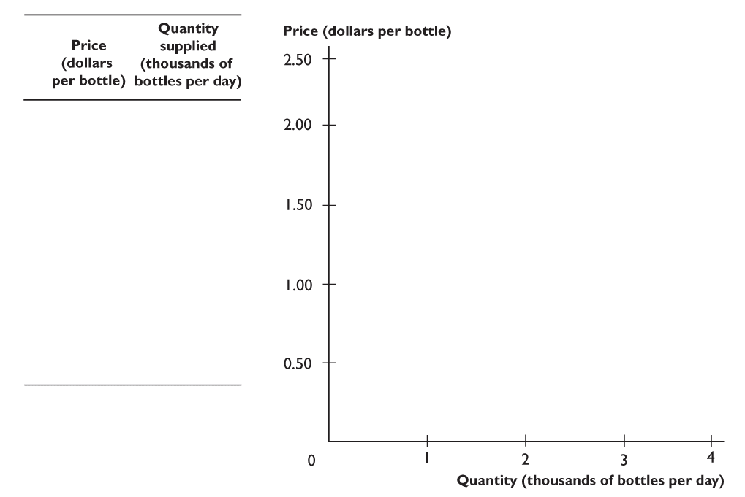
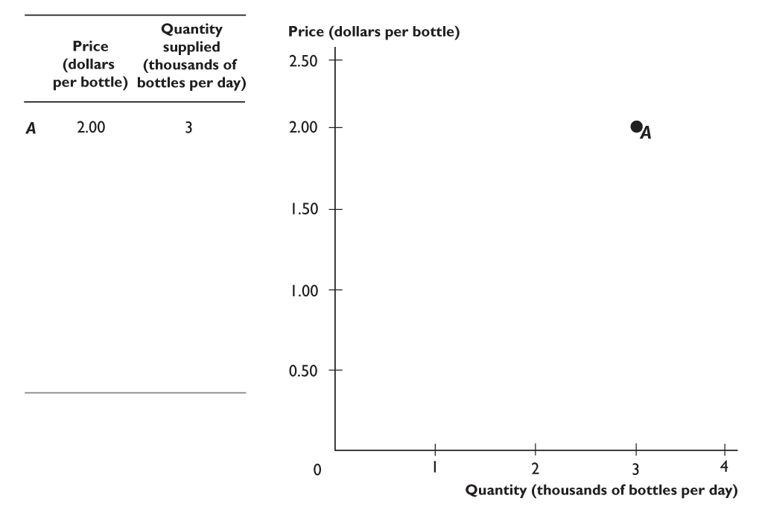
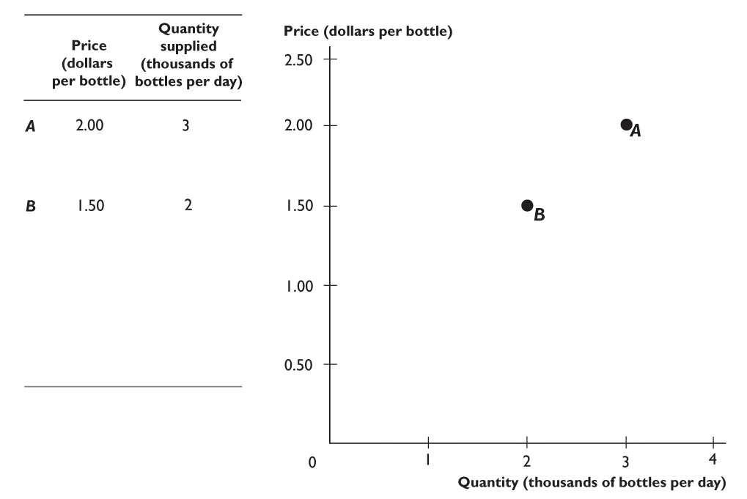
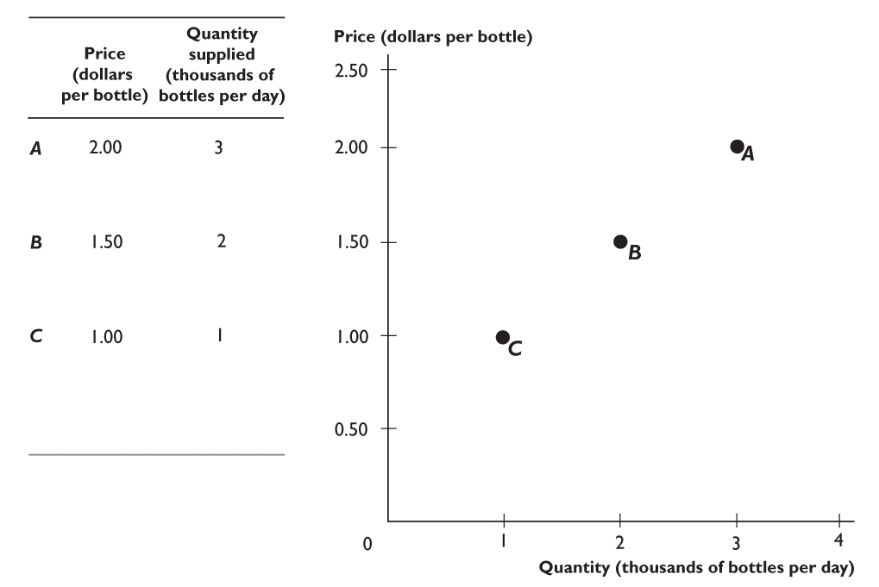
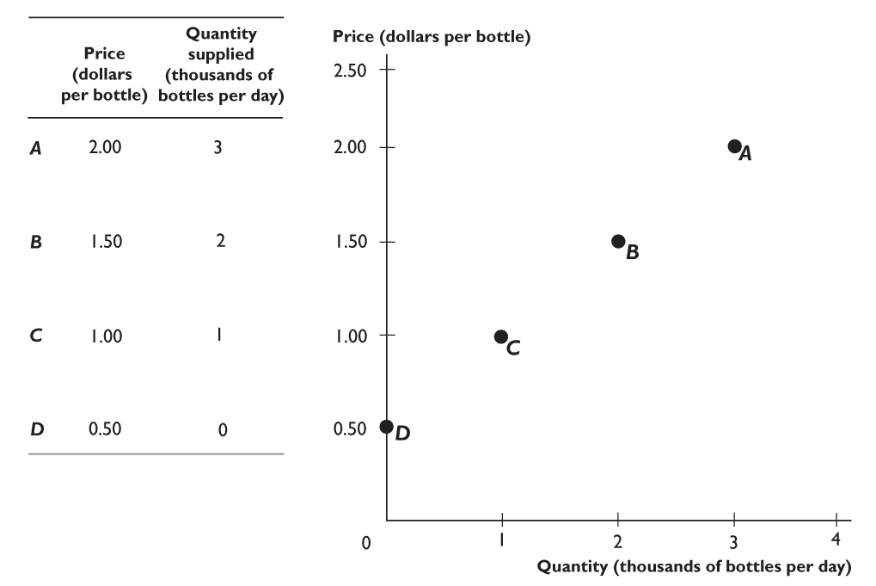
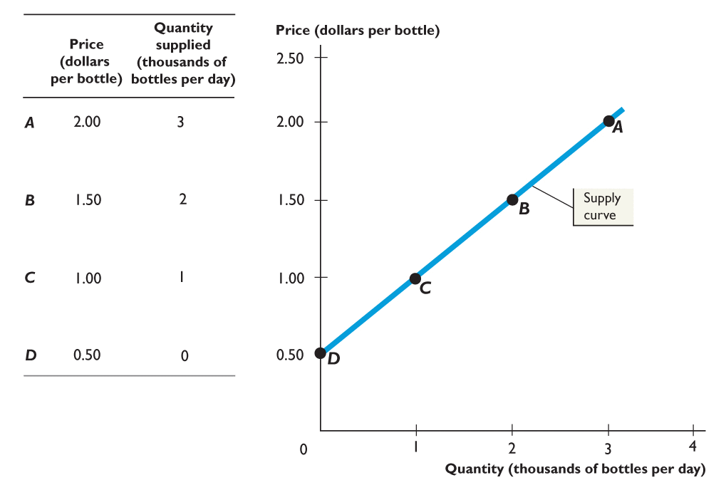

Slide 32
Shifts in Supply versus Movements Along a Supply Curve
Supply refers to a schedule of quantities of a good a seller is willing to sell per unit of time at various prices, other things constant
Refers to the entire supply curve
Supply tells us how much will be sold at various prices
A change in anything other than price that affects the supply curve changes the entire supply curve
A change in the entire supply curve is a shift in supply

Slide 33
Shifts in Supply versus Movements Along a Supply Curve
Movement along a supply curve
P
Supply
C
A change in price causes a movement along the supply curve
$80
$50
B
Q
4.1
4.3

Slide 34
Shifts in Supply versus Movements Along a Supply Curve
Shift in Supply
P
S₀
S₁
A change in a shift factor causes a shift in supply
Q

Slide 35
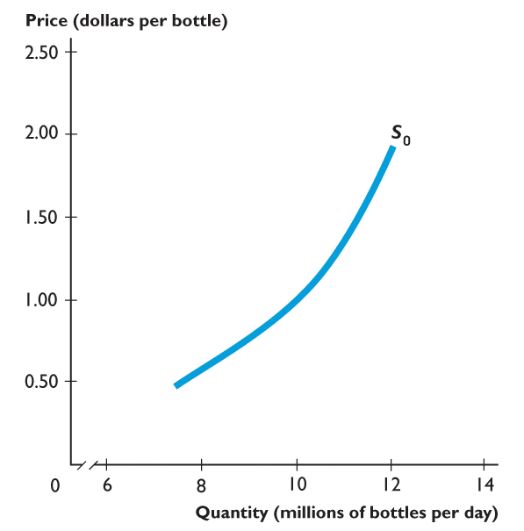
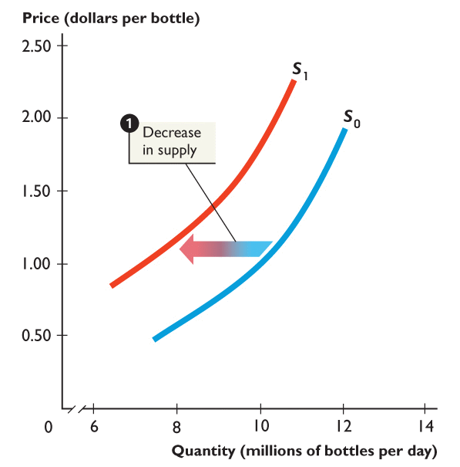
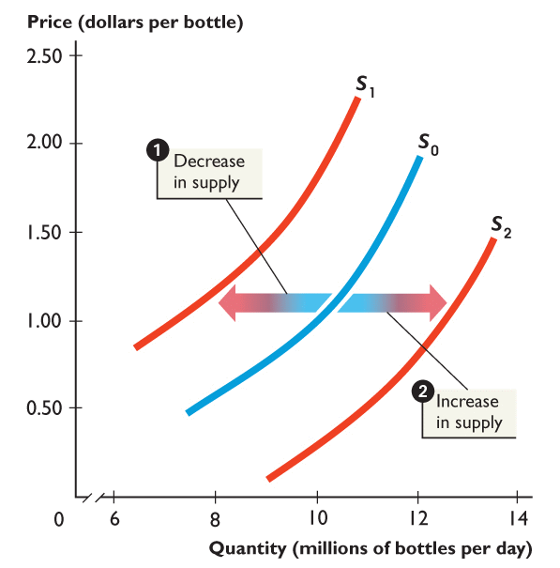
Figure shows changes in supply.
1. When supply decreases, the supply curve shifts leftward from S₀ to S₁.
2. When supply increases, the supply curve shifts rightward from S₀ to S₂.
Notes:
When you draw a shift of the supply curve, again be careful to draw the arrows in the horizontal direction. Follow the text by always describing shifts of supply curves as “rightward” or “leftward.” Do not say that the curves shift “up” or “down.” This description of a shift is especially confusing for the supply curve. A rightward shift of the supply curve makes it look as if the curve is moving lower. Students who do not think in terms of “rightward” and “leftward” believe this shift reflects a decrease in supply, which is wrong. Get the student to always go left and right and draw the shift arrows too.

Slide 36
Shift Factors in Supply
Important supply shift factors include:
Price of inputs
Technology
Expectations
Prices of substitutes in production
Number of firms in the market
Taxes and subsidies

Slide 37
Changes in prices of inputs
Inputs are things used in the production of a good or service.
Examples of inputs for smartphones:
Computer processor
Plastic housing
Labor
An increase in the price of an input decreases the profitability of selling the good, causing a decrease in supply.
A decrease in the price of an input increases the profitability of selling the good, causing an increase in supply.
Effect of an increase in the price of input goods
Effect of a decrease in the price of input goods

Slide 38
Technological change
A firm may experience a positive or negative change in its ability to produce a given level of output with a given quantity of inputs. This is a technological change.
Changes raise or lower firms’ costs, hence their supply of the good.
Examples:
A new, more productive variety of wheat would increase the supply of wheat.
Governmental restrictions on land use for agriculture might decrease the supply of wheat.
Effect of a positive change in technology
Effect of a negative change in technology

Slide 39
Change in expected future prices
If a firm anticipates the price of its product will be higher in the future, it might decrease its supply today in order to increase it in the future.
What types of products could be “stored” like this?
Perishable products, or
Non-perishable products
Effect of an increase in future expected price of a good

Slide 40
Prices of substitutes, and number of firms
Many firms can produce and sell more than one product.
Example:
An Illinois farmer can plant corn or soybeans. If the price of soybeans rises, he will plant (supply) less corn.
More firms in the market will result in more product available at a given price (greater supply).
Fewer firms → supply decreases.
Effect on the supply of corn, of an increase in the price of soybeans
Effect of a increase in the number of firms

Slide 41
Taxes and Subsidies
Taxes levied on producers increase the cost of goods to producers and therefore reduce supplyfor those goods.
Subsidies to producers have the opposite effect.
Effect of taxes on supply

Slide 42
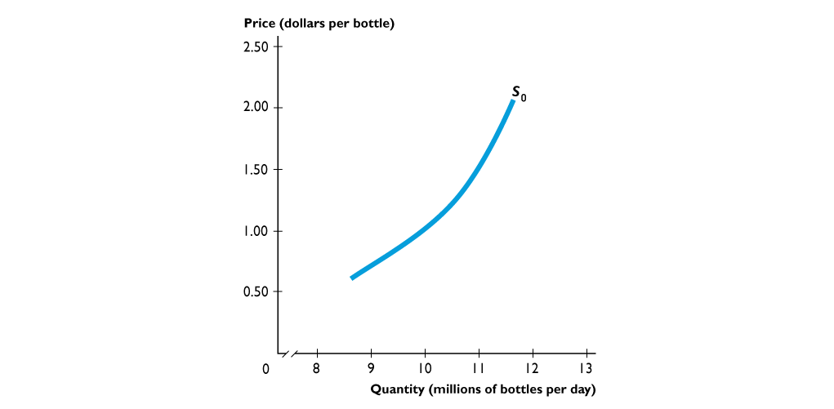
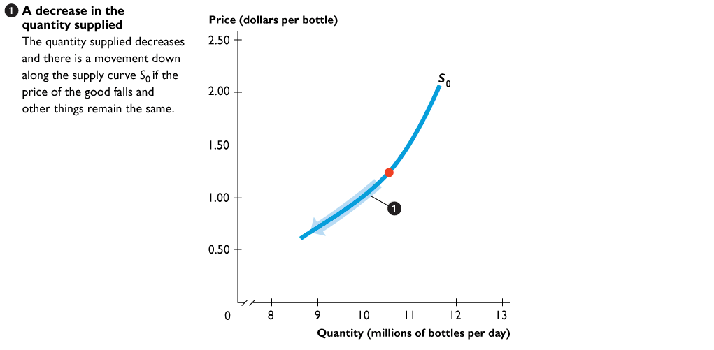
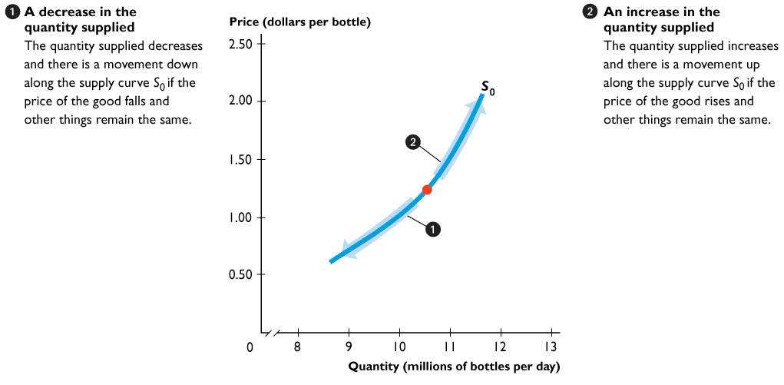
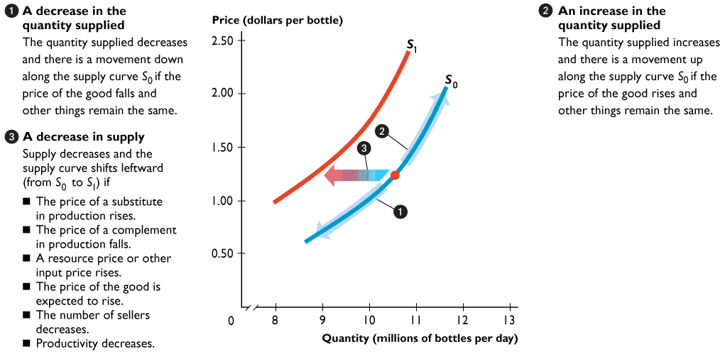
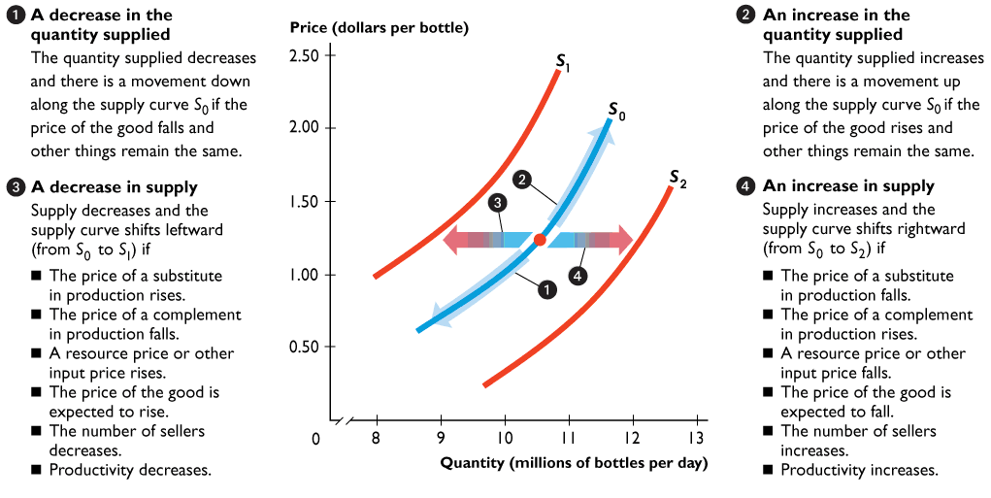

Slide 43
Individual and Market Supply Curves
Price (per movie) | Ann’s Supply | + Barry’s supply | + Charlie’s supply | = Market supply
$1.00 | 1 | 0 | 0 | 1
$3.00 | 3 | 2 | 0 | 5
$5.00 | 5 | 4 | 0 | 9
$7.00 | 7 | 5 | 2 | 14

Slide 44
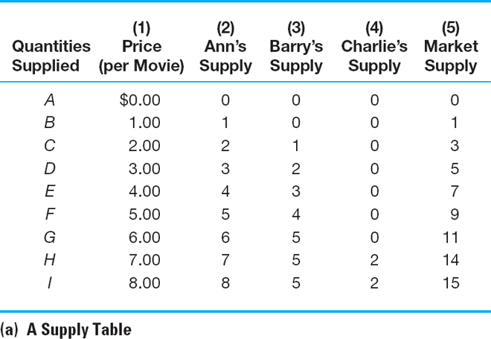
Individual and Market Supply Curves

Slide 45
Individual and Market Supply Curves
Market supply curve for movies per week
The market supply curve is the summation of all individual supply curves
P
CHARLIE
BARRY
ANN
$7.00
$5.00
$3.00
Market supply for movies
$1.00
Q
2
4
6
8
10
12
13
1
3
5
7
9
11
14
15

Slide 46
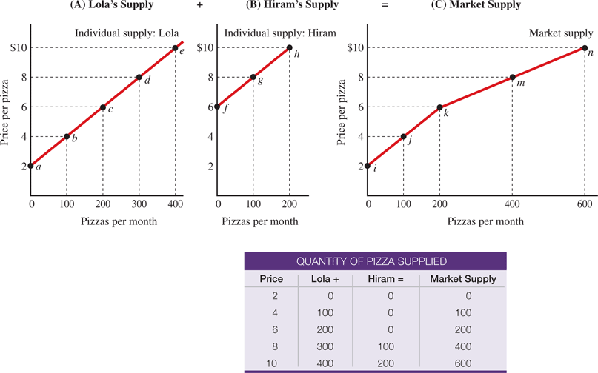
From Individual Supply to Market Supply
The market supply is the sum of the supplies of all firms. In Panel A, Lola is a low-cost producer who produces the first pizza once the price rises above $2 (shown by point a).
Panel B, Hiram is a high-cost producer who doesn’t produce pizza until the price rises above $6 (shown by point f ).
To draw the market supply curve, we sum the individual supply curves horizontally. At a price of $8, market supply is 400 pizzas (point m), equal to 300 from Lola (point d) plus 100 from Hiram (point g).

Slide 47
Six Things to Remember about a Supply Curve
A supply curve follows the law of supply. When price rises, quantity supplied increases, and vice versa.
The horizontal axis—quantity—has a time dimension.
The quality of each unit is the same.
The vertical axis—price—assumes all other prices remain constant.
The supply curve assumes everything else is constant.
Effects of price changes are shown by movements along the supply curve. Effects of nonprice determinants of supply are shown by shifts of the entire supply curve.

Slide 48
The Interaction of Supply and Demand
Equilibrium is a concept in which opposing dynamic forces cancel each other out
Market equilibrium occurs when the quantity demanded equals the quantity supplied. At market equilibrium, buyers’ and sellers’ plans are consistent.
Equilibrium price is the price at which the quantity demanded equals the quantity supplied.
Equilibrium quantity is the quantity bought and sold at the equilibrium price.

Slide 49
The Interaction of Supply and Demand
If there is an excess supply (a surplus), quantity supplied is greater than quantity demanded
If there is an excess demand (a shortage), quantity demanded is greater than quantity supplied
Prices adjust and tend to rise when there is excess demand and fall when there is excess supply to reach an equilibrium

Slide 50
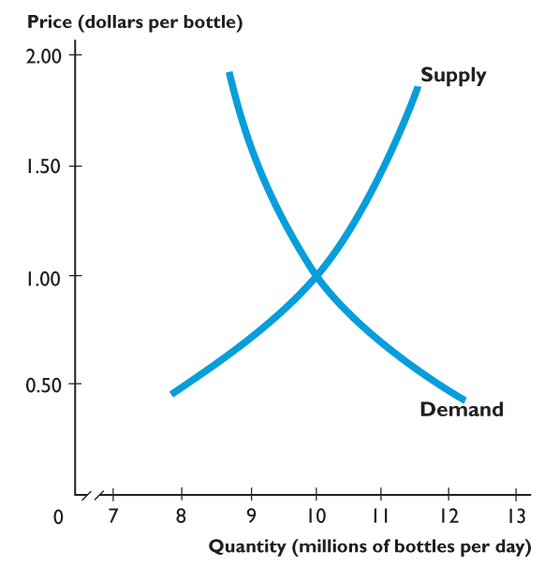
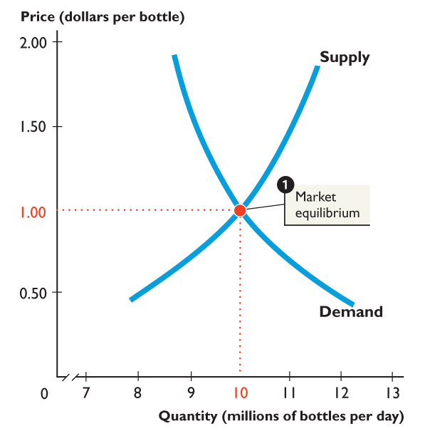
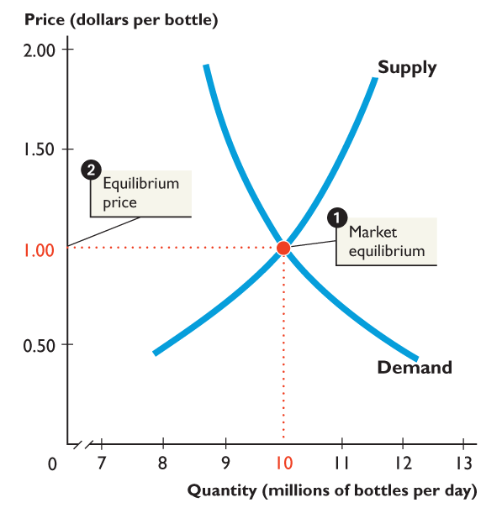
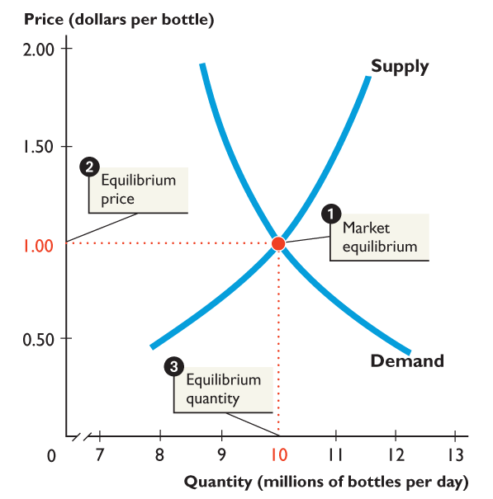
MARKET EQUILIBRIUM
Figure shows the
equilibrium price and
equilibrium quantity.
1. Market equilibrium at the intersection of the demand curve and the supply curve.
2. The equilibrium price is $1 a bottle.
3. The equilibrium quantity is 10 million bottles a day.

Slide 51
The Interaction of Supply and Demand
P
Excess supply
Supply
Excess supply causes downward pressure on price
P₁
P*
Excess demand causes upward pressure on price
P₀
Excess demand
Demand
Q

Slide 52
Shifts in Supply and Demand
Shifts in either supply or demand change equilibrium price
An increase in demand or a decrease in supply
Creates excess demand at the original equilibrium price
Excess demand increases price until a new higher equilibrium prince is reached
A decrease in demand or an increase in supply
Creates excess supply at the original equilibrium price
Excess supply decreases price until a new lower equilibrium price is reached

Slide 53
A decrease in supply
P
S₁
S₀
A decrease in supply generates excess demand. Price will increase until a new, higher, equilibrium price is reached
P₁
P₀
Excess demand
D₀
Q
Q₁
Q₀

Slide 54
A decrease in demand
P
S₀
Excess supply
A decrease in demand generates excess supply. Price will decrease until a new, lower, equilibrium price is reached
P₀
P₁
D₀
D₁
Q
Q₁
Q₀

Slide 55
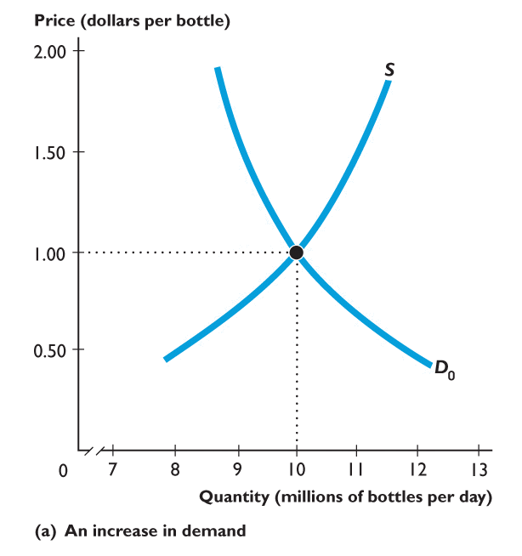
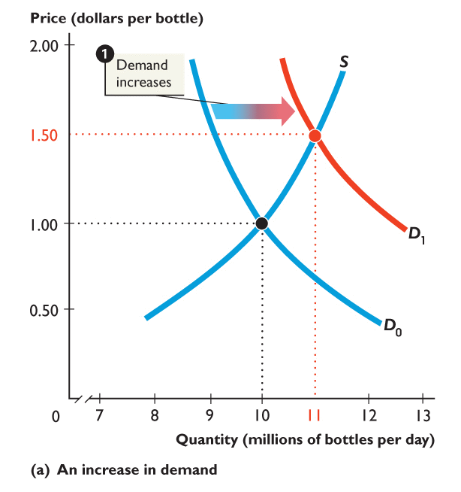
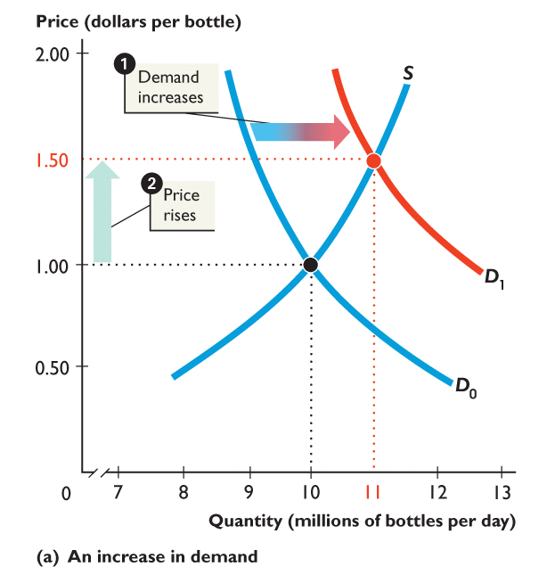
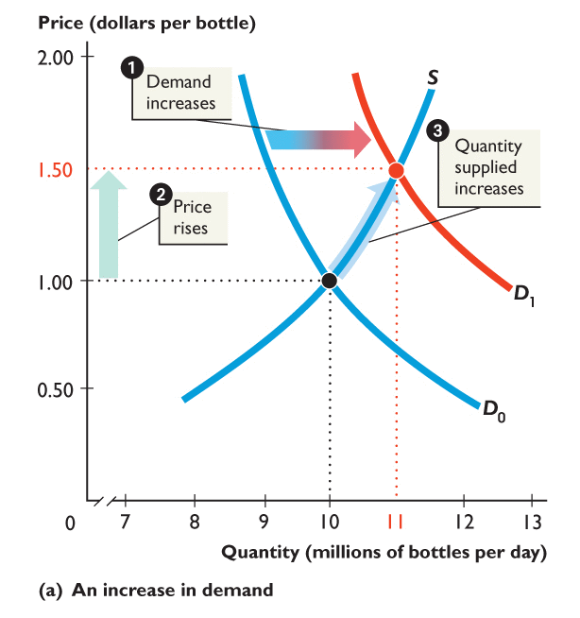
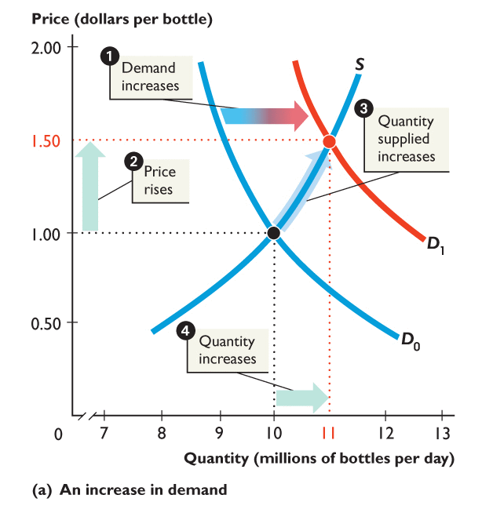
Increase in Demand
1. An increase in demand shifts the demand curve rightward.
2. At $1.00 a bottle, there is a shortage, so the price rises.
3. The quantity supplied increases along the supply curve.
4. Equilibrium quantity increases.
Notes:
Tell students that they will do much better on the exam if they DRAW the demand-supply graph to answer a question.
Show them how much easier it is to see the effects of a change in demand or a change in supply or both on the equilibrium price and equilibrium quantity if they draw the graph.

Slide 56
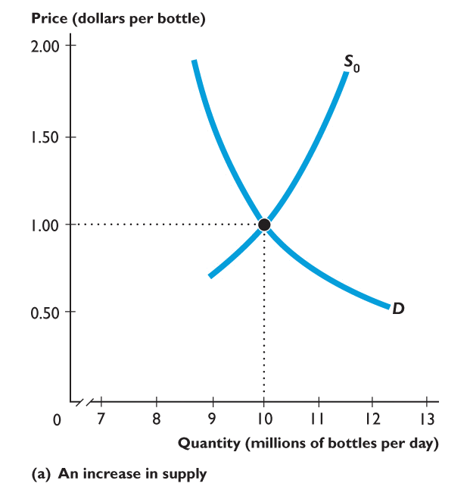
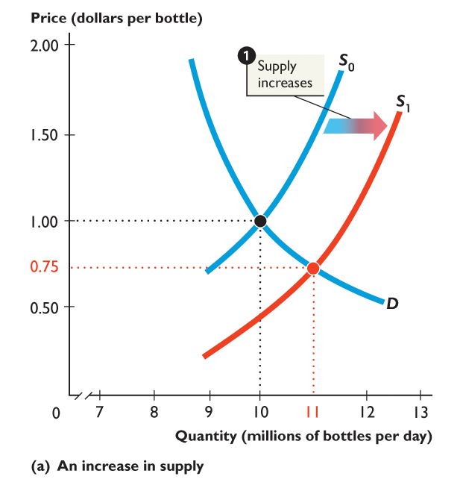
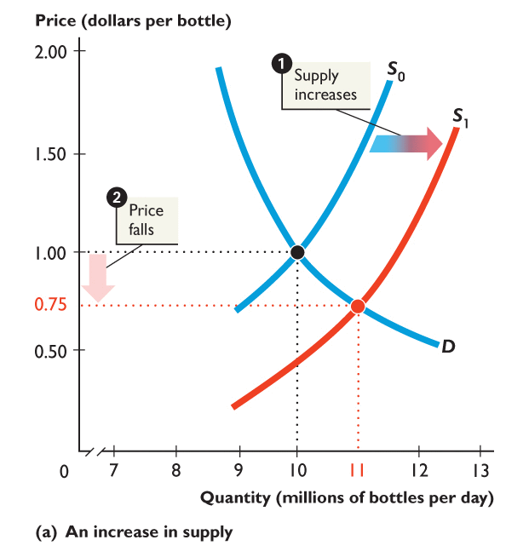
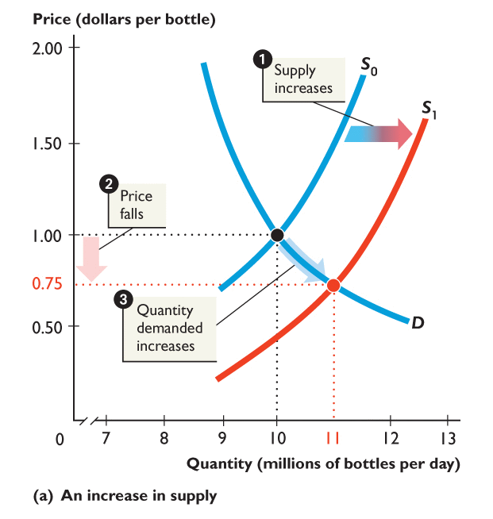
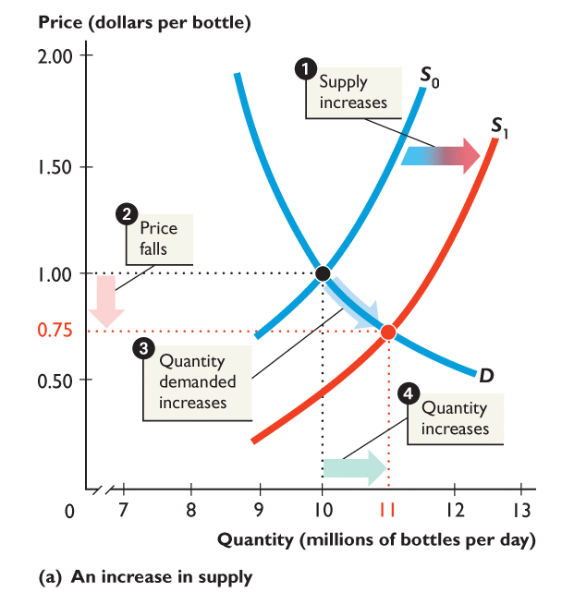
An increase in supply
1. An increase in supply shifts the supply curve rightward.
2. At $1 a bottle, there is a surplus, so the price falls.
3. Quantity demanded increases along the demand curve.
4. Equilibrium quantity increases.

Slide 58
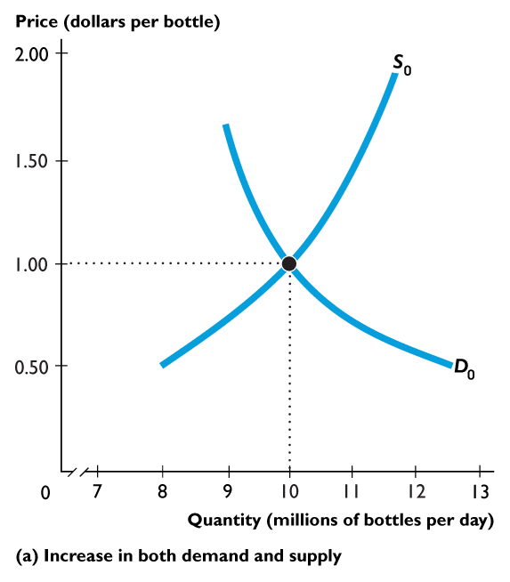
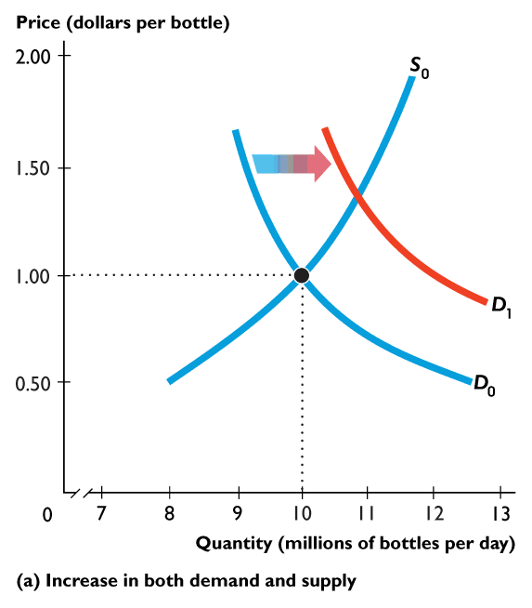
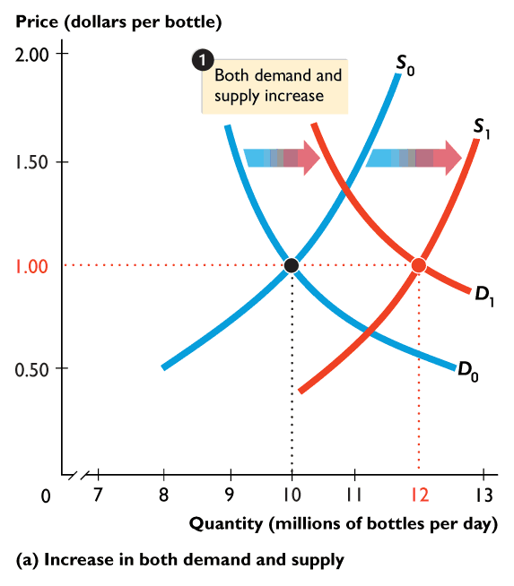
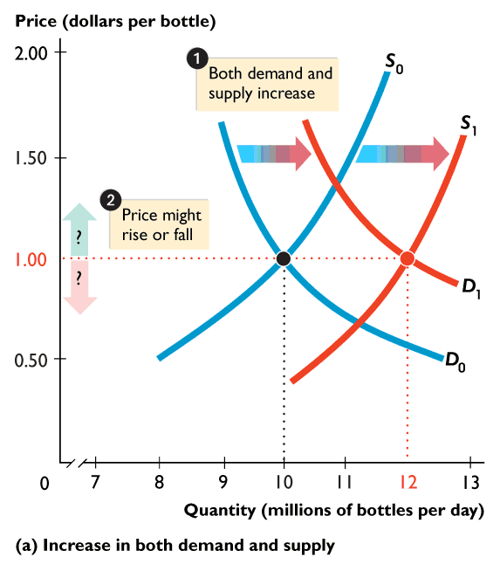
Figure shows the effects of an increase in both demand and supply.
1. An increase in demand shifts the demand curve rightward.
An increase in supply shifts the supply curve rightward.
2. Equilibrium price might rise, fall, or not change.
3. Equilibrium quantity increases.

Slide 59
Figure shows the effects of a decrease in both demand and supply.
1. A decrease in demand shifts the demand curve leftward.
A decrease in supply shifts the supply curve leftward.
2. Equilibrium price might rise, fall or not change.
3. Equilibrium quantity decreases.

Slide 60
Figure shows the effects of a decrease in demand and an increase in supply.
1. A decrease in demand shifts the demand curve leftward.
An increase in supply shifts the supply curve rightward.
2. Equilibrium price falls.
3. Equilibrium quantity might increases, decrease or not change.

Slide 61
Figure shows the effects of an increase in demand and a decrease in supply.
1. An increase in demand shifts the demand curve rightward.
A decrease in supply shifts the supply curve leftward.
2. Equilibrium price rises.
3. Equilibrium quantity might increases, decrease or not change.

Slide 62
The Algebra of Supply and Demand
For computing numerical values, it is more convenient to find equilibrium prices and quantities algebraically
The supply schedule is: P= 2 + 3Q^{s}
Its demand schedule is: P = 10 – Q^{d}
In equilibrium we know that Q^{s =} Q^{d}, denoting this common value as Q*, we arrive at:
2 + 3Q* = 10 – Q*
Which gives Q* = 2, substituting this back into either the supply or demand equation gives the equilibrium price, P* = 8

Slide 63
Graphs of the Supply and Demand Equations

Slide 64
Arthur O'Sullivan, Steven Sheffrin, Stephen Perez (2014) Microeconomics: Principles, Applications, and Tools, Pearson New International Edition, 8th Edition.
Karl E. Case, Ray C. Fair, Sharon M. Oster (2017) Principles of Microeconomics, Global Edition, 12th Edition.
Robin Bade, Michael Parkin (2019) Foundations of Microeconomics, Global Edition, 8th Edition.
D. C. Colander (2013), Economics, McGraw-Hill (2013), Ninth Edition. Lectures will draw heavily from this book. Additional readings may be distributed.

