Slide 1
ECON 575 FUNDAMENTALS OF ECONOMICS CHAPTER 3 Government Intervention Prof. Dr. Dilek TEMİZ DİNÇ

Slide 2
Government Intervention
The invisible hand is not the only factor in determining prices; social and political forces also determine price.
Other factors include:
Price ceilings and price floors
Excise taxes and tariffs
Quantity restrictions

Slide 3
Price controls
Price controls are legal restrictions on how high or low a market price may go.
2 kinds of price controls:
Price Ceilings: a maximum price sellers are allowed to charge for a good. It’s an upper limit for the price.
Price Floors: a minimum price buyers are required to pay for a good. It’s a lower limit for the price.

Slide 4
Why Price controls?
During crisis times, emergencies or wars the government wants to protect the consumers from rapidly increasing prices.
If the equilibrium wage given by supply and demand for low skilled workers is below poverty level, the government can set a minimum wage.

Slide 5
Government Intervention: Price Ceilings
When a government wants to hold prices down to favor buyers, it imposes a price ceiling
A price ceiling is a government-imposed limit on how high a price can be charged
Price ceilings create shortages
Price ceilings below equilibrium price will have an effect on the market
With price ceilings, existing goods are no longer rationed entirely by price so other methods of rationing arise

Slide 6
A price ceiling is a government regulation that places an upper limit on the price at which a particular good, service, or factor of production may be traded.
An example is a price ceiling on housing rents.
Trading above the price ceiling is illegal.

Slide 7
Price Ceilings
Equilibrium
Price ceiling
Price
Price
S
D
S
D
4
4
3
3
Price Ceiling
2
2
Shortage
100
200
Quantity of icecreams
100
200
800
Quantity of icecreams

Slide 8
Application: Rent Controls
Housing
P(rental price per month)
After WWII, rent controls (a form of price ceiling) were put in place
S₀
The rent controls caused a housing shortage
$17
There would not be a shortage if rents had been allowed to increase to the equilibrium price of $17
$2.50
D₀
Shortage
Q_{S}
Q_{D}
Q (number of apartments)

Slide 9
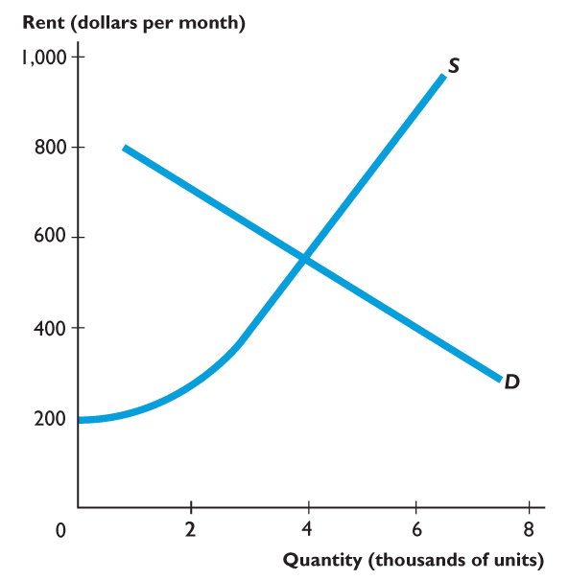
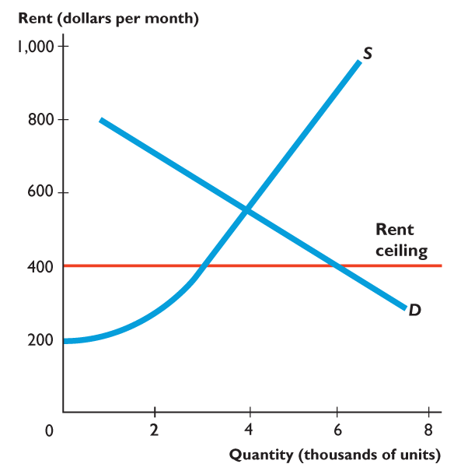
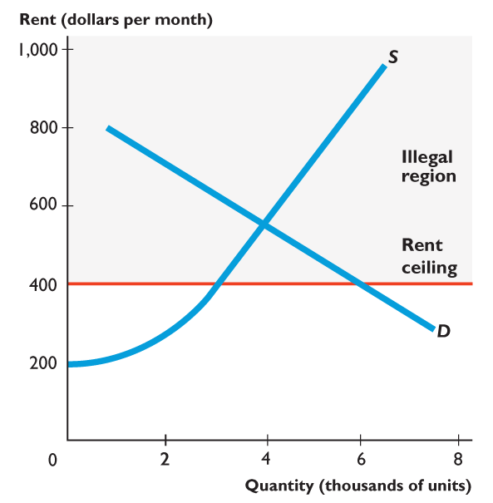
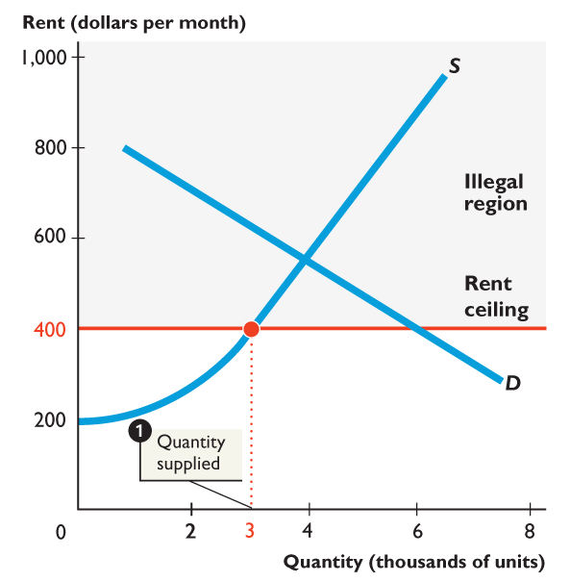
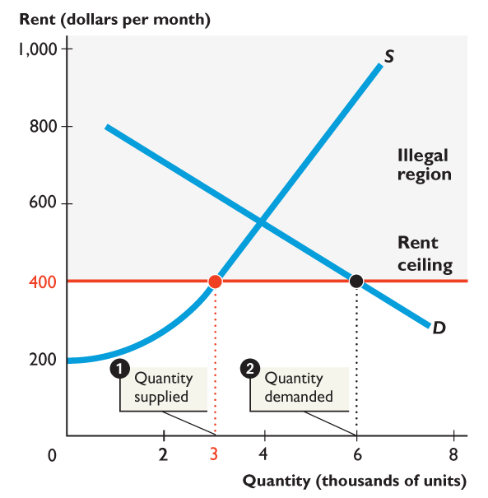
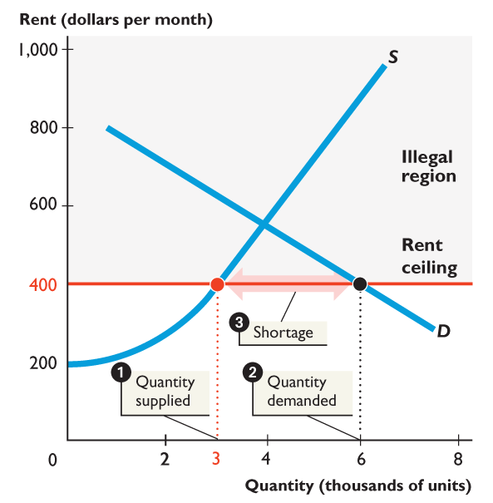
Figure shows how a rent ceiling creates a shortage.
A rent ceiling is imposed at $400 a month, which is below the market equilibrium rent.
1. The quantity of housing supplied decreases to 3,000 units.
2. The quantity of housing demanded increases to 6,000 units.
3. A shortage of 3,000 units arises.

Slide 10
Because of these ceilings, we are faced with a shortage.
The shortage will lead to inefficiencies:
A market or an economy is inefficient if there are missed opportunities: some people could be made better off without making other people worse off.

Slide 11
Let’s take a look at the different possible inefficiencies:
Inefficient Allocation to Consumers
Wasted Resources
Inefficiently Low Quality
Black Markets

Slide 12
Price controls: price ceilings
Inefficient Allocation to Consumers
Price ceilings can lead to inefficiency in the form of inefficient allocation to consumers: people who really want the good and are willing to pay a high price don’t get it, and those who are not so interested in the good and are only willing to pay a low price do get it.
Example: rent control. In such case people get the appartment usually through luck or personal connections.

Slide 13
Price controls: price ceilings
Wasted Resources
Price ceilings typically lead to inefficiency in the form of wasted resources: people spend money, time and expend effort in order to deal with the shortages caused by the price ceiling.
You waste a lot of time looking for a good (e.g. an appartment) in case of shortage, the time has it’s value! You can work or just rest, do something better than look for a good you’ can’t find.

Slide 14
Price controls: price ceilings
Inefficiently Low Quality
Price ceilings often lead to inefficiency in that the goods being offered are of inefficiently low quality
In case of rent controls, the landlords will not improve the conditions of the appartments, there is no incentive since the rental fee is low but the main reason is that since there is a shortage, people are willing to rent the apartment as it is, even in bad condition!

Slide 15
Price controls: price ceilings
Black Markets
A black market is a market in which goods or services are bought and sold illegally—either because it is illegal to sell them at all or because the prices charged are legally prohibited by a price ceiling.
If someone for example bribes (gives extra money) to the apartment owners he will get the apartment, but the honest people that don’t break the law will never find one this way!

Slide 16
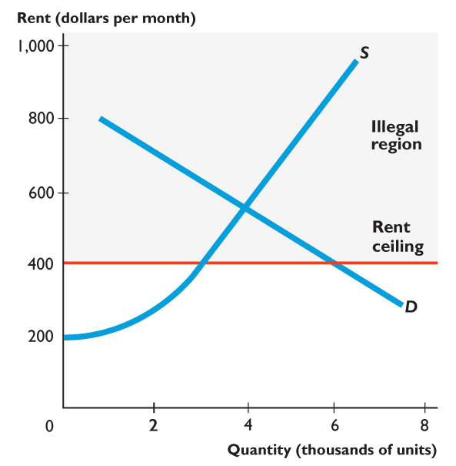
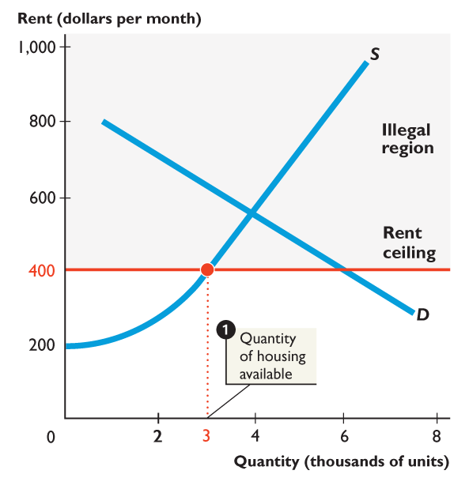
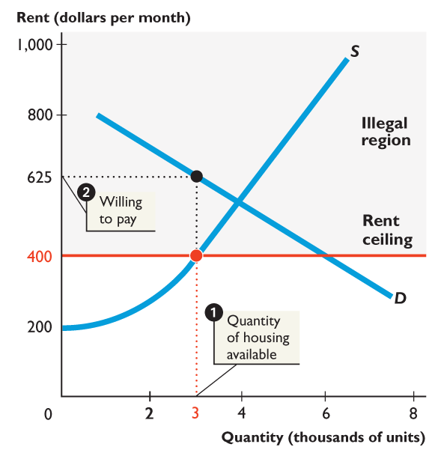
Figure shows how a rent ceiling creates a black market and housing search.
With a rent ceiling of $400 a month:
1. 3,000 units of housing are available.
2. Someone is willing to pay $625 a month for the 3,000th unit of housing.

Slide 17
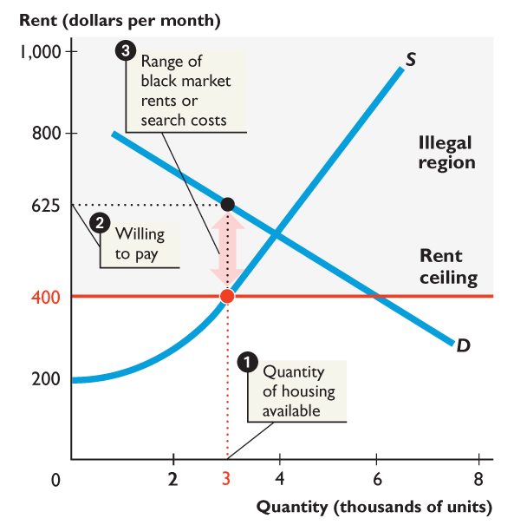
3. Black market rents might be as high as $625 a month and resources get used up in costly search activity.

Slide 18
Are Rent Ceilings Efficient?
With a rent ceiling, the outcome is inefficient.
Marginal benefit exceeds marginal cost.
Total surplus—the sum of producer surplus and consumer surplus—shrinks and a deadweight loss arises.
People who can’t find housing and landlords who can’t offer housing at a lower rent lose.

Slide 19
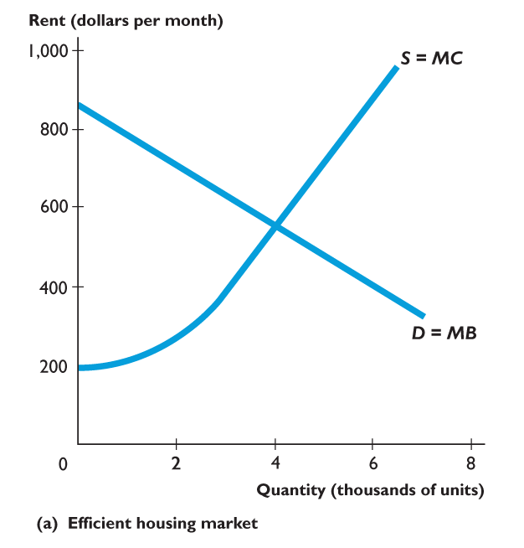
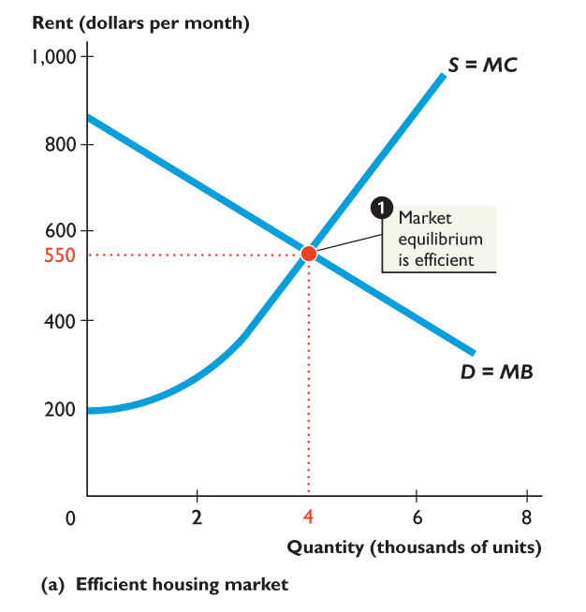
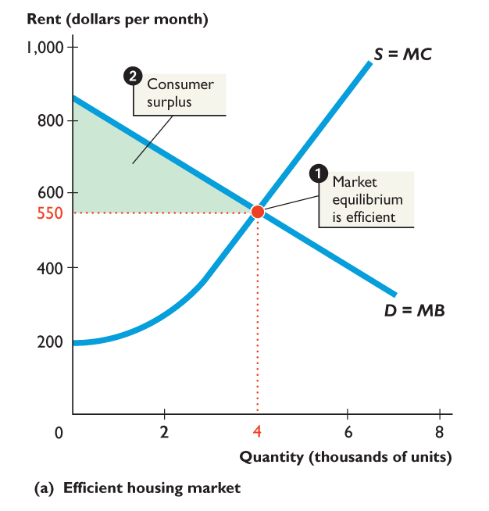
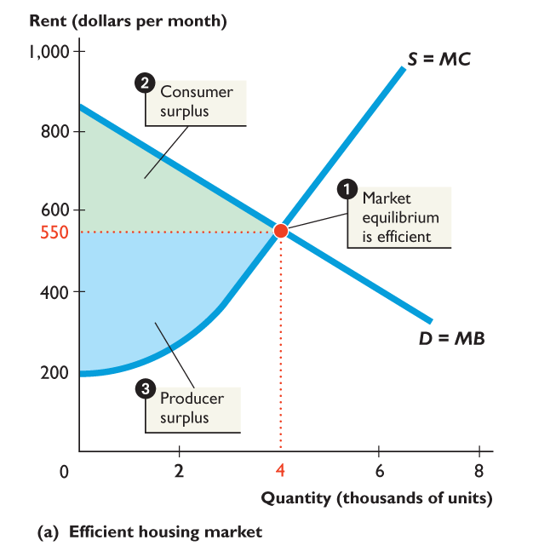
Figure shows an efficient housing market.
1. The market is efficient with marginal benefit equal to marginal cost.
2. Consumer surplus plus ...
3. Producer surplus is as large as possible.

Slide 20
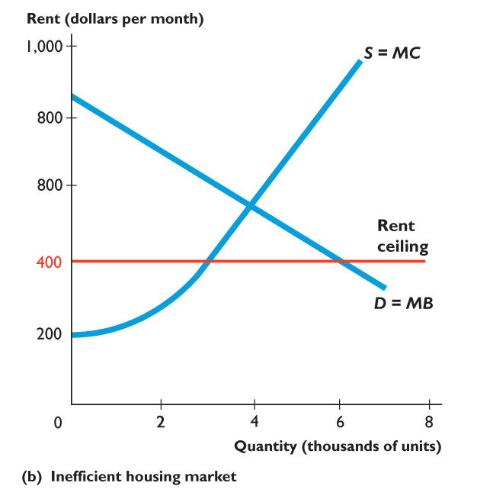
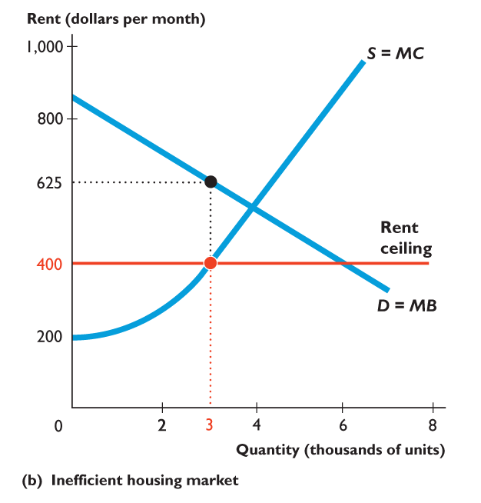
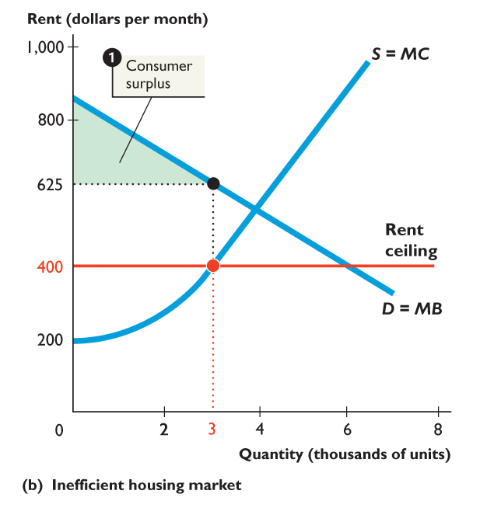
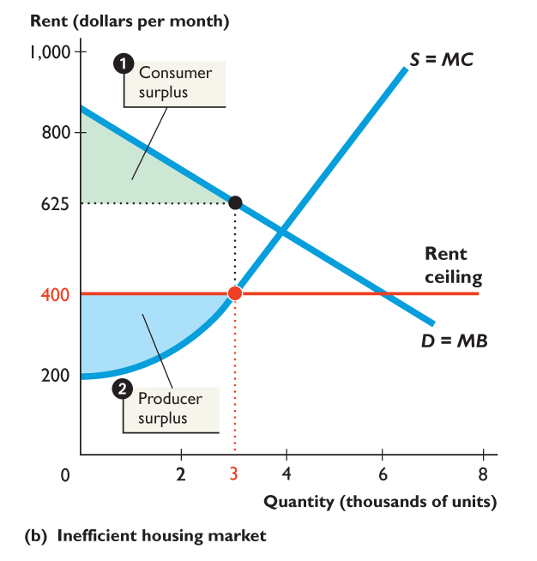
Figure shows the inefficiency of a rent ceiling.
A rent ceiling restricts the quantity supplied and marginal benefit exceeds marginal cost.
1. Consumer surplus shrinks.
2. Producer surplus shrinks.

Slide 21
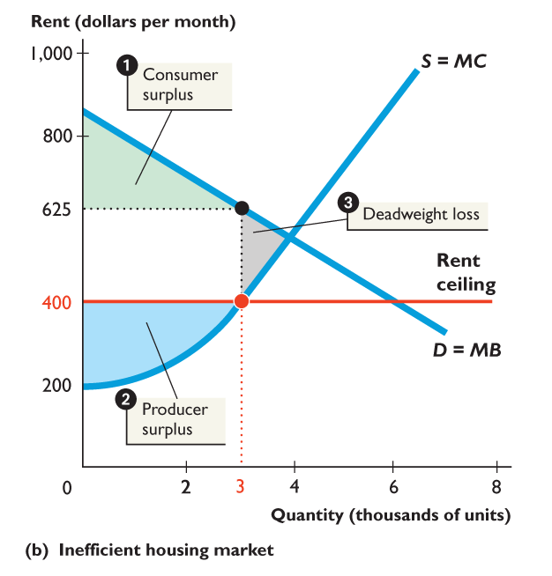
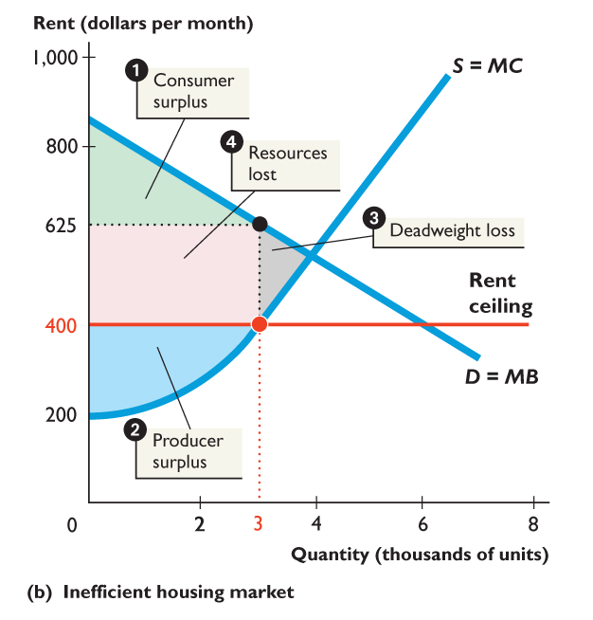
3. A deadweight loss arises.
4. Other resources are lost in search activity and evading and enforcing the rent ceiling law.
Resource use is inefficient.

Slide 22
Government Intervention: Price Floors
When a government wants to prevent a price from falling below a certain level to favor suppliers, it imposes a price floor
A price floor is a government-imposed limit on how low a price can be charged
Price floors create excess supply
Price floors above equilibrium price will have an effect on the market

Slide 23
A price floor is a government regulation that places a lower limit on the price at which a particular good, service, or factor of production may be traded.
An example is the minimum wage in labor markets.
Trading below the price floor is illegal.

Slide 24
Price controls: price floors
Equilibrium
Price floor
Price
Price
Surplus
D
S
D
S
4
4
3
3
Price Ceiling
2
2
100
200
Quantity of icecreams
200
Quantity of icecreams
100
600

Slide 25
The Minimum Wage
A minimum wage law is a government regulation that makes hiring labor for less than a specified wage illegal.
Firms can pay a wage rate above the minimum wage but they may not pay a wage rate below the minimum wage.
The effect of a minimum wage depends on whether it is set above or below the market equilibrium wage rate.

Slide 26
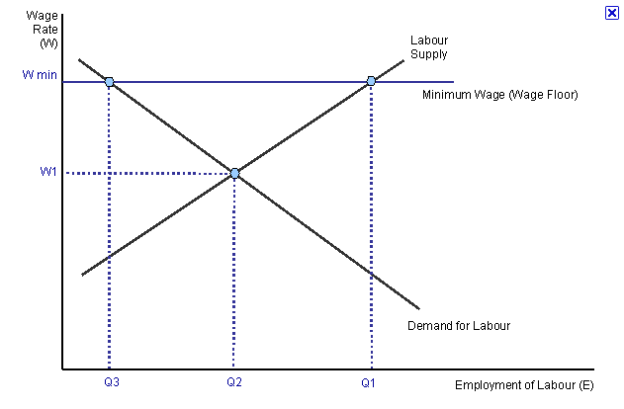

Slide 27
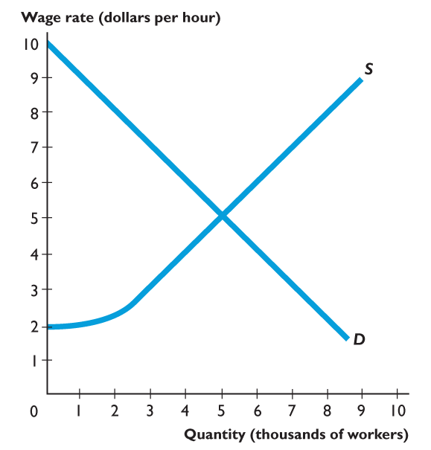
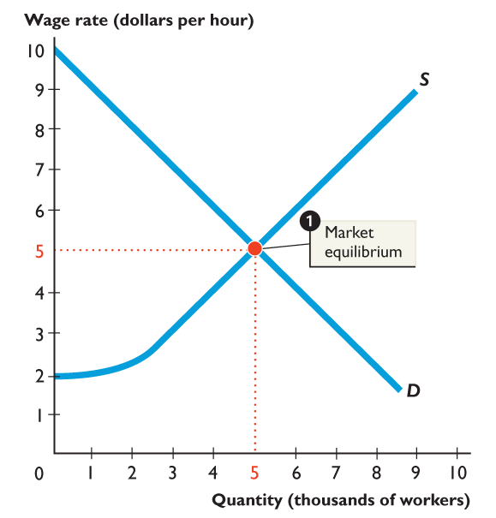
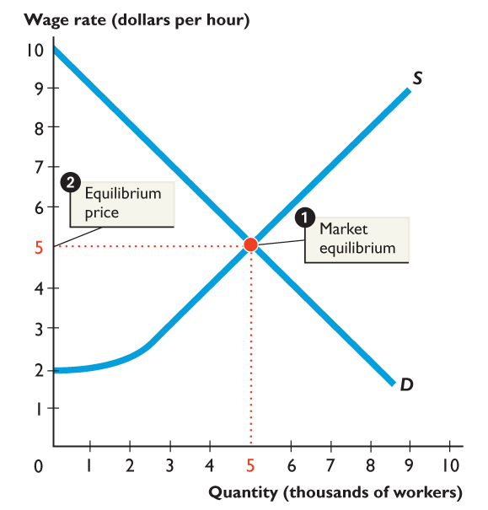
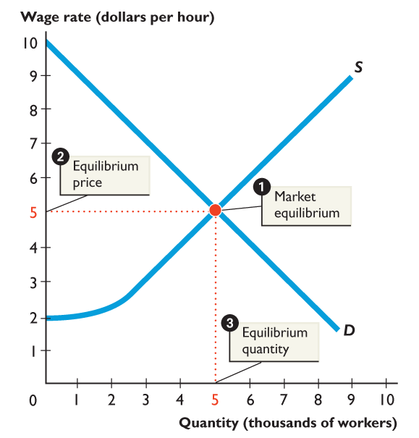
PRICE FLOORS
Figure shows a market for fast-food servers.
1. The demand for and supply of fast-food servers determine the market equilibrium.
2. The equilibrium wage rate is $5 an hour.
3. The equilibrium quantity is 5,000 servers.

Slide 28
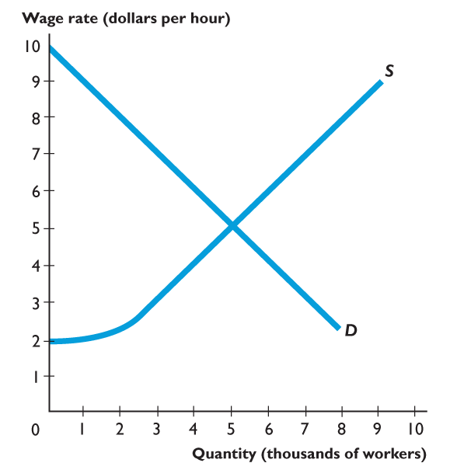
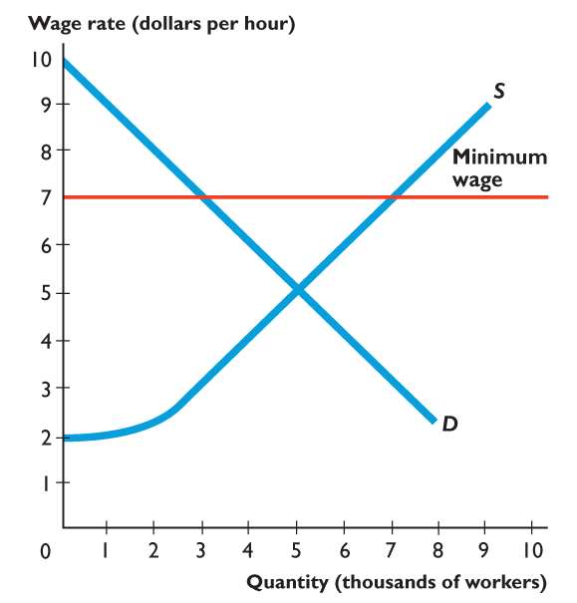
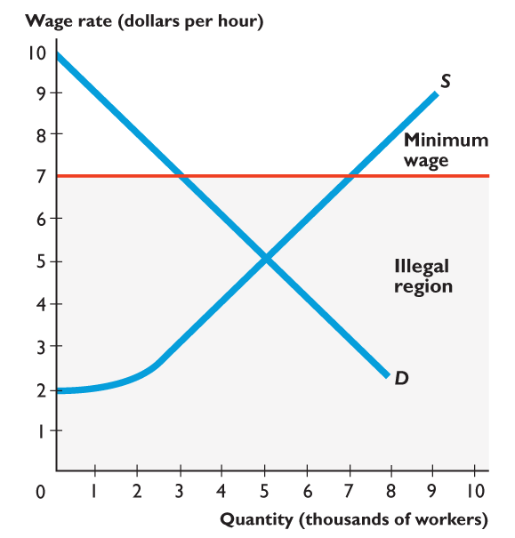
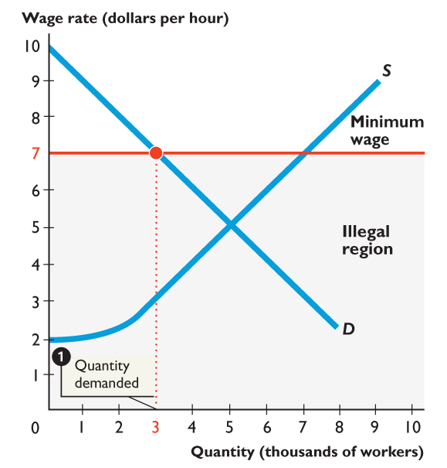
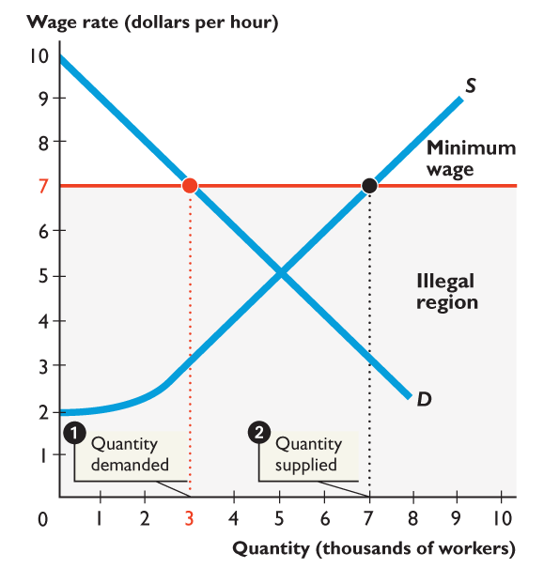
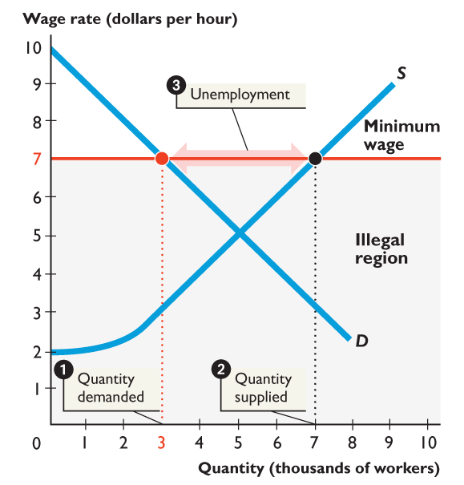
PRICE FLOORS
Figure shows how a minimum wage creates unemployment.
A minimum wage is set above the equilibrium wage.
1. The quantity demanded decreases to 3,000 workers.
2. The quantity supplied increases to 7,000 people.
3. 4,000 people are unemployed.

Slide 29
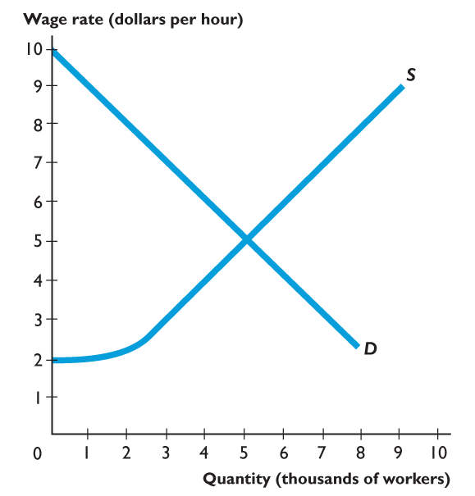
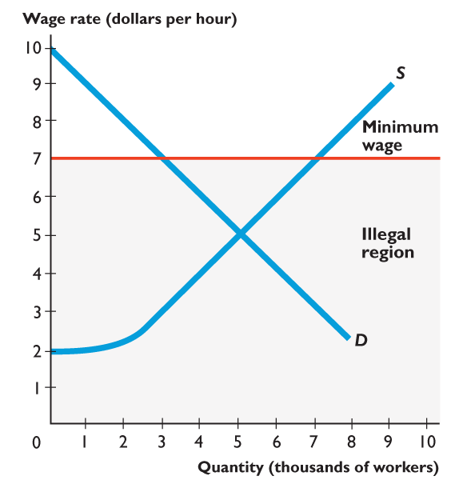
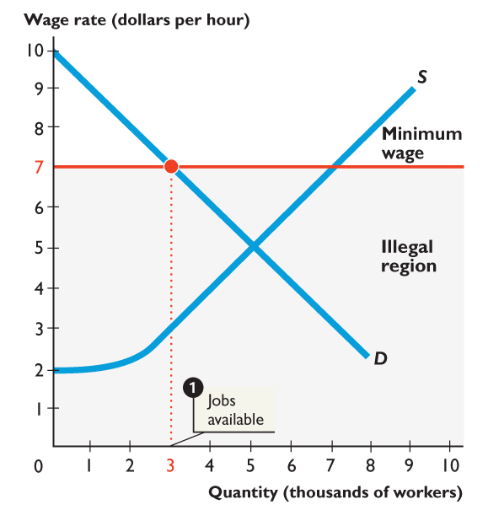
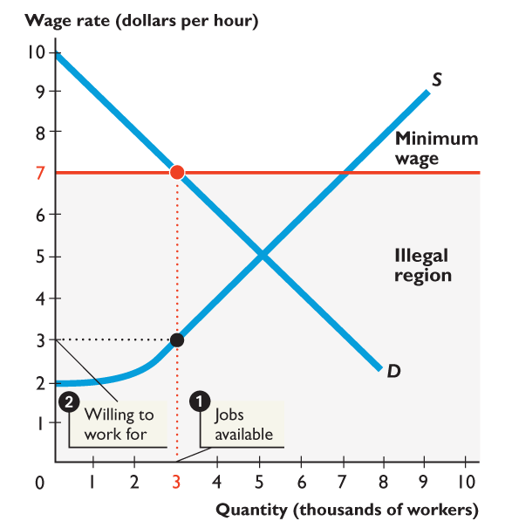
PRICE FLOORS
Figure shows how a minimum wage increases job search.
1. At the minimum wage rate of $7 an hour, 3,000 jobs are available.
2. Someone is willing to take the 3,000th job for $3 an hour.

Slide 30
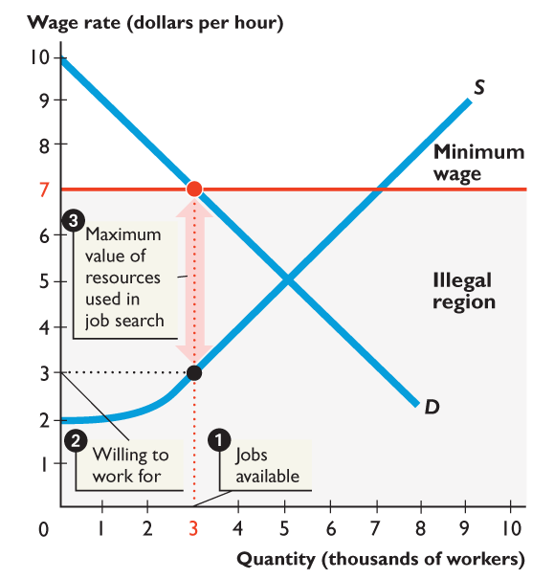
3. Illegal wage rates might range from just below $7 an hour to $3 an hour.
People are willing to spend time on job search that is worth the equivalent of lowering their wage rate by $4 an hour.

Slide 31
Is the Minimum Wage Efficient?
The firms’ surplus and workers’ surplus shrink, and a deadweight loss arises.
Firms that cut back employment and people who can’t find jobs at the higher wage rate lose.
The total loss exceeds the deadweight loss because resources get used in costly job-search activity.

Slide 32
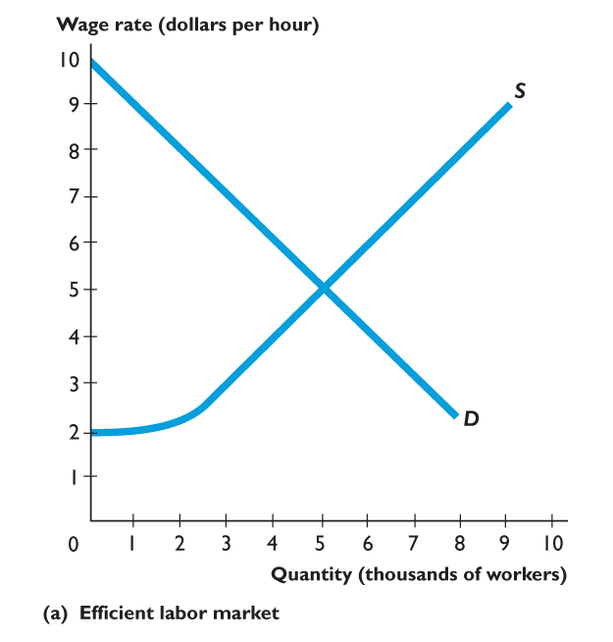
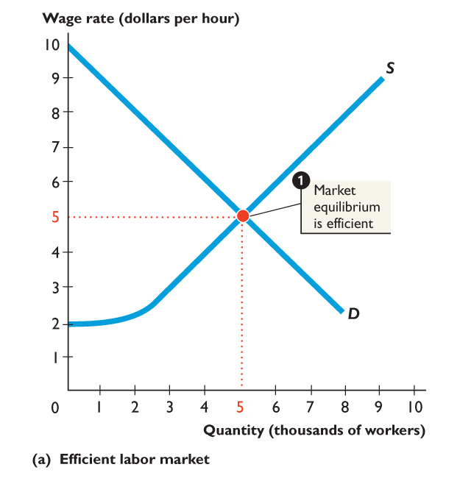
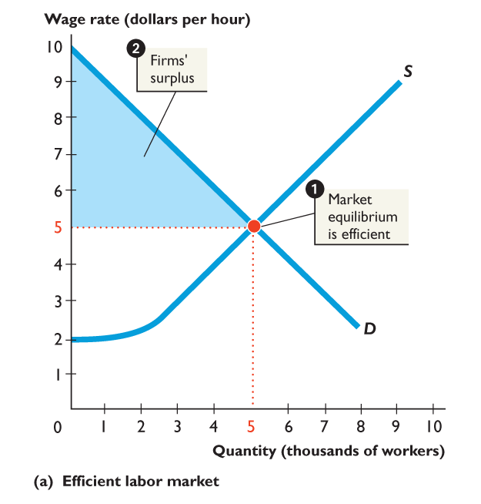
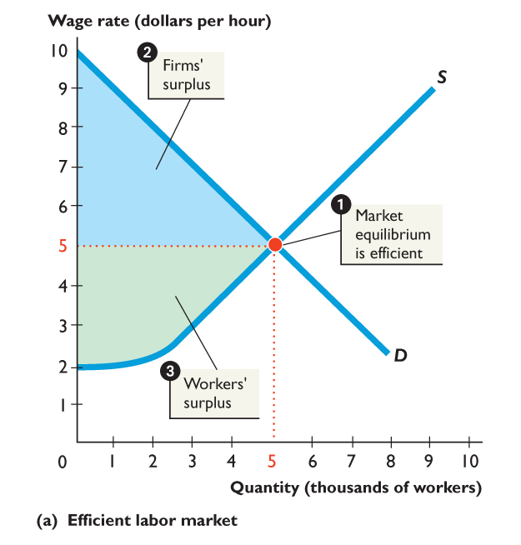
Figure shows an efficient labor market.
1. At the market equilibrium, the marginal benefit of labor to firms equals the marginal cost of working.
2. The sum of the firms’ and workers’ surpluses is as large as possible.

Slide 33
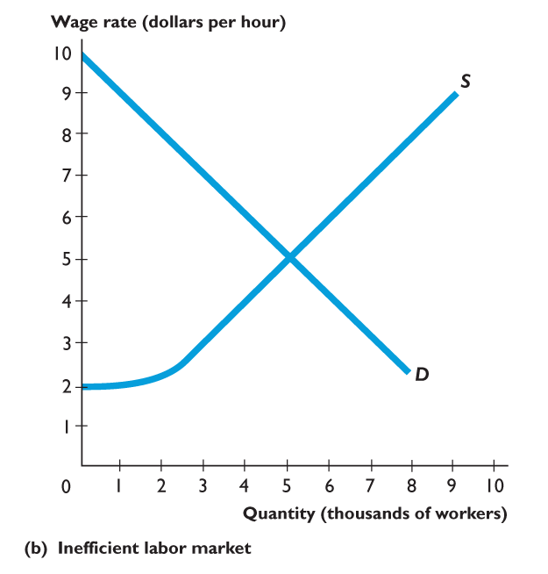
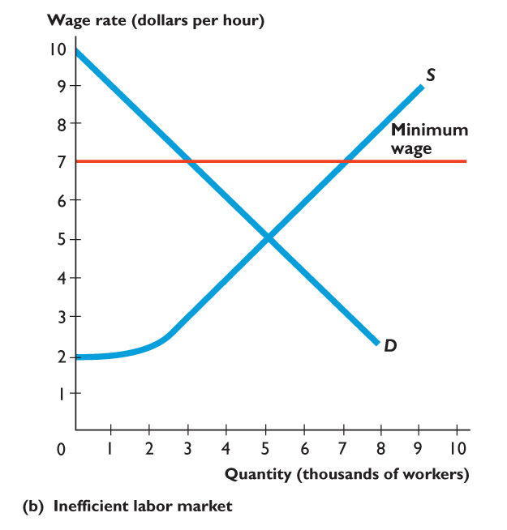
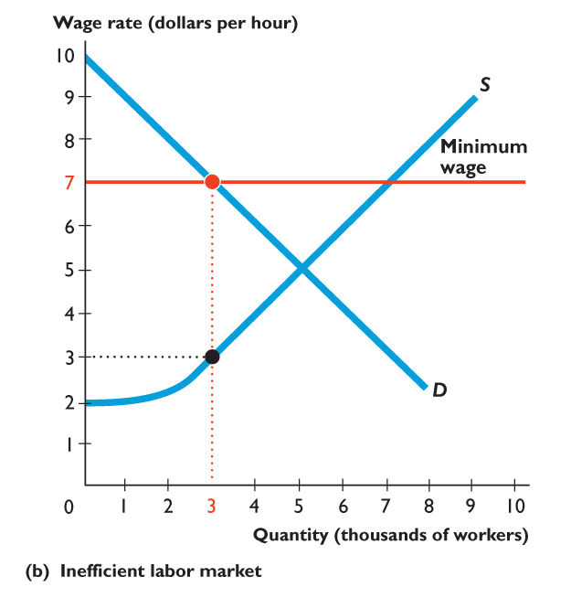
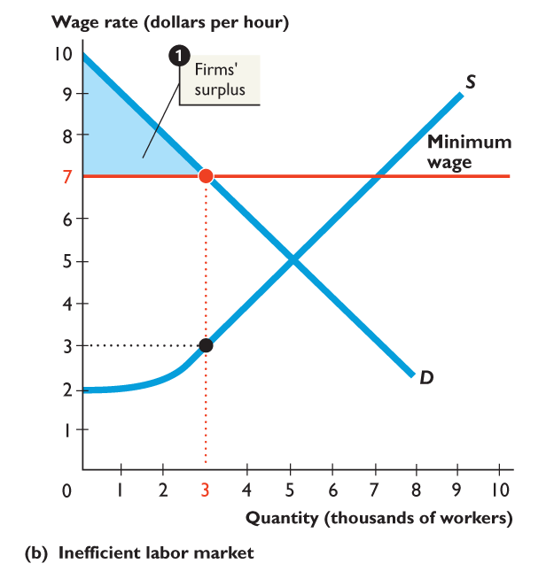
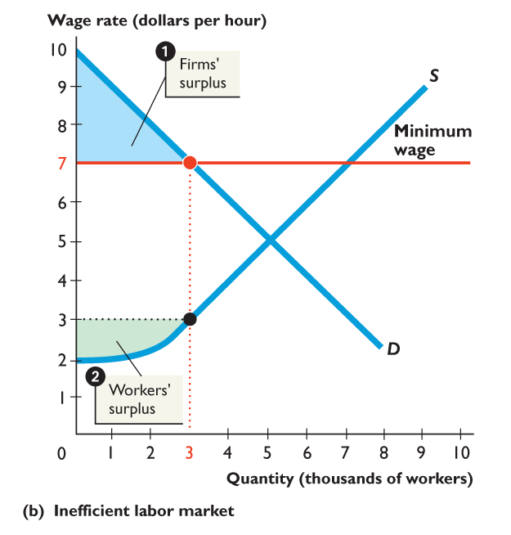
Figure shows an inefficient labor market with a minimum wage.
The minimum wage restricts the quantity demanded.
1. The firms’ surplus shrinks.
2. The workers’ surplus shrinks.

Slide 34
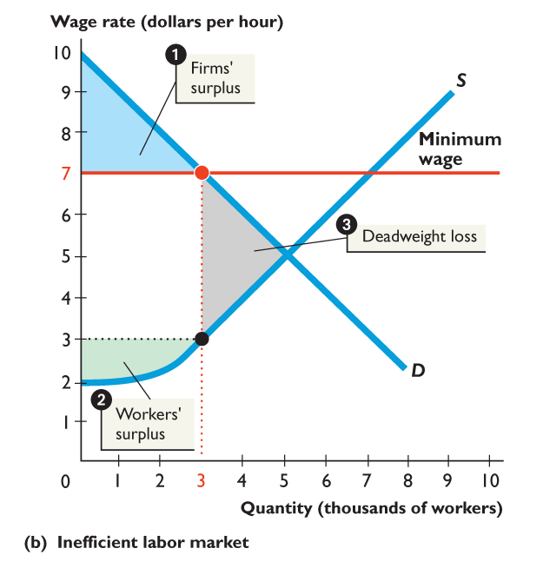
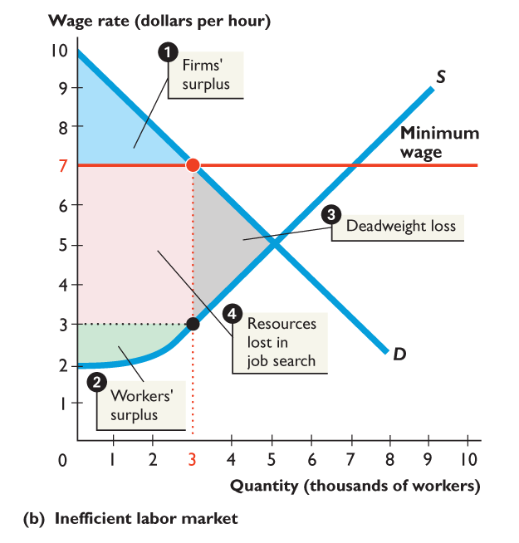
3. A deadweight loss arises.
4. Other resources are used up in job-search activity.
The outcome is inefficient.

Slide 35
Why a Price Floor Causes Inefficiency
Inefficient Allocation of Sales Among Sellers
Price floors lead to inefficient allocation of sales among sellers: those who would be willing to sell the good at the lowest price are not always those who actually manage to sell it. Example: Farm Subsidies
Wasted Resources
Like a price ceiling, a price floor generates inefficiency by wasting resources.

Slide 36
Government Intervention: Excise Taxes
Government impacts markets through taxation
An excise tax is a tax that is levied on a specific good
A tariff is an excise tax on an imported good
The result of taxes and tariffs is an increase in equilibrium prices and reduce equilibrium quantities

Slide 37
The Effect of an Excise Tax
Luxury Boats
Price
S1
Government imposes a $10,000 luxury tax on the suppliers of boats
S0
$70,000
$65,000
Tax = $10,000
The supply curve shifts up by the amount of the tax
$60,000
The price of boats rises by less than the tax to $65,000
$10,000
D0
420
510
600
Quantity

Slide 38
Government Intervention: Quantity Restrictions
Government regulates markets with licenses, which limit entry into a market
Many professions require licenses, such as doctors, financial planners, cosmetologists, electricians, or taxi cab drivers
The results of limited number of licenses in a market are increases in wages and an increases in the price of obtaining the license

Slide 39
The Effect of a Quantity Restriction
NYC Taxi Drivers
P (wages per week )
Successful lobbying by taxi cab drivers in NYC resulted in quantity restrictions (medallions)
Q_{R}
When the demand for taxi services increased, because the number of taxi licenses was limited, wages increased
D₁
$15
D₀
Q (number of licensed taxis)
12,000

Slide 40
The Effect of a Quantity Restriction
NYC Taxis Medallions
P (price of taxi medallion)
The demand for taxi medallions also increased because wages were increasing. But because the number of taxi licenses was limited, the price of a medallion also increased
QR
$400,000
Initial Fee
D1
D0
Q (number of taxi of medallions)
12,000

Slide 41
Chapter Summary
You can describe almost all events in terms of supply and demand
Price ceilings, government imposed limits on how high a price can be charged, create shortages
Price floors, government-imposed limits on how low a price can be charged, create surpluses
Taxes and tariffs paid by suppliers shift the supply curve up by the amount of the tax or tariff and increase equilibrium price and decrease quantity
Quantity restrictions increase equilibrium price and reduce equilibrium quantity

Slide 42
Arthur O'Sullivan, Steven Sheffrin, Stephen Perez (2014) Microeconomics: Principles, Applications, and Tools, Pearson New International Edition, 8th Edition.
Karl E. Case, Ray C. Fair, Sharon M. Oster (2017) Principles of Microeconomics, Global Edition, 12th Edition.
Robin Bade, Michael Parkin (2019) Foundations of Microeconomics, Global Edition, 8th Edition.
D. C. Colander (2013), Economics, McGraw-Hill (2013), Ninth Edition. Lectures will draw heavily from this book. Additional readings may be distributed.

