Slide 1
ECON 575
FUNDAMENTALS OF ECONOMICS
CHAPTER 7
COSTS
Prof. Dr. Dilek TEMİZ DİNÇ

Slide 2
In this chapter our goal is to translate the theory of production into a theory of costs. Previously, we established the relationship between the quantities of inputs employed and the corresponding level of output. Here, we will create the link between the quantity of output produced and the cost of producing it.

Slide 3
Our first step will be to tackle the question of how costs vary with output in the short run. This question turns out to be more involved than it sounds, for there are seven different types of costs to keep track of—total cost, variable cost, fixed cost, marginal cost, average total cost, average variable cost, and average fixed cost. This array sounds bewildering at first, but the links between the different cost concepts are actually clear and simple. And each turns out to be important for the study of firm behavior, our principal concern in the chapters to follow.

Slide 4
Of even greater importance for the structure and conduct of industry is the question of how costs vary with output in the long run. Here, we will begin with the question of how to produce a given level of output—say, a mile of road—at the lowest possible cost. A given quantity can be produced many ways: We need to find the cheapest way, the most appropriate method for existing factor prices. The answer to this question enables us to explore how costs are related to returns to scale in production.

Slide 5
WHAT ARE COSTS?
The Firm’s Objective
  The economic goal of the firm is to maximize profits.
Maximum Profits

Slide 6
Total Revenue, Total Cost, and Profit
Total Revenue
  The amount a firm receives for the sale of its output.
Total Cost
  The market value of the inputs a firm uses in production.

Slide 7
Total Revenue, Total Cost, and Profit
Profit is the firm’s total revenue minus its total cost.
Profit = Total revenue - Total cost

Slide 8
Costs as Opportunity Costs
A firm’s cost of production includes all the opportunity costs of making its output of goods and services.
Explicit and Implicit Costs
  A firm’s cost of production include explicit costs and implicit costs.
    Explicit costs are input costs that require a direct outlay of money by the firm.
    Implicit costs are input costs that do not require an outlay of money by the firm.

Slide 9
Economic Profit versus Accounting Profit
Economists measure a firm’s economic profit as total revenue minus total cost, including both explicit and implicit costs.
Accountants measure the accounting profit as the firm’s total revenue minus only the firm’s explicit costs.

Slide 10
Economic Profit versus Accounting Profit
When total revenue exceeds both explicit and implicit costs, the firm earns economic profit.
Economic profit is smaller than accounting profit.

Slide 11
Economists versus Accountants
How an Economist
How an Accountant
Views a Firm
Views a Firm
Economic
profit
Accounting
profit
Implicit
Revenue
costs
Revenue
Total
opportunity
costs
Explicit
Explicit
costs
costs

Slide 12
Costs In the Short Run
Fixed cost (FC): cost that does not vary with the level of output in the short run (the cost of all fixed factors of production).
Variable cost (VC): cost that varies with the level of output in the short run (the cost of all variable factors of production).
Total cost (TC): all costs of production: the sum of variable cost and fixed cost.

Slide 13
Short-Run Cost
Total Cost
  A firm’s total cost (TC) is the cost of all resources used.
  Total fixed cost (TFC) is the cost of the firm’s fixed inputs. Fixed costs do not change with output.
  Total variable cost (TVC) is the cost of the firm’s variable inputs. Variable costs do change with output.
  Total cost equals total fixed cost plus total variable cost. That is:
  TC = TFC + TVC

Slide 14
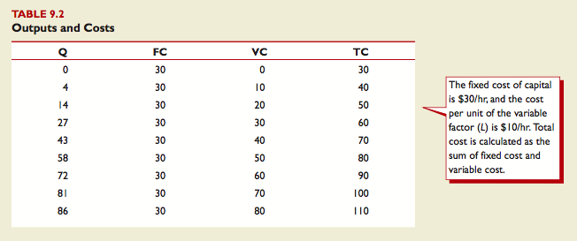
Costs In the Short Run

Slide 15
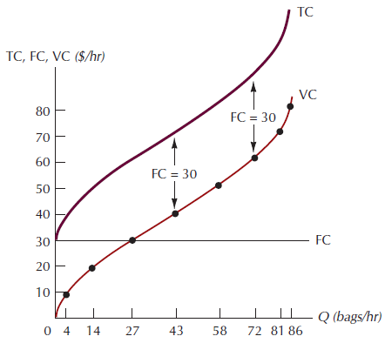
Graphing The Total, Variable, and Fixed Cost Curves
The Total, Variable, and
Fixed Cost Curves
The variable cost
curve passes through the
origin, which means that the
variable cost of producing
zero units of output is equal
to zero. The TC curve, which
is the sum of the FC and VC
curves, is parallel to the VC
curve and lies FC = 30 units
above it.

Slide 16





Other Short-Run Costs
Average fixed cost (AFC): fixed cost divided by the quantity of output.
Average variable cost (AVC): variable cost divided by the quantity of output.
Average total cost (ATC): total cost divided by the quantity of output.
Marginal cost (MC): change in total cost that results from a 1-unit change in output.

Slide 17
Average and Marginal Cost Curves
The marginal cost curve goes through the minimum point of the average total cost curve and average variable cost curve.
Each of these curves is U-shaped.
The average fixed cost curve slopes down continuously.

Slide 18
Downward-Sloping Shape of the Average Fixed Cost Curve
The average fixed cost curve looks like a child’s slide – it starts out with a steep decline, then it becomes flatter and flatter.
It tells us that as output increases, the same fixed cost can be spread out over a wider range of output.

Slide 19
The U Shape of the Average and Marginal Cost Curves
The law of diminishing marginal productivity sets in as more and more of a variable input is added to a fixed input.
Marginal and average productivities fall and marginal costs rise.
And when average productivity of the variable input falls, average variable cost rise.

Slide 20
The U Shape of the Average and Marginal Cost Curves
The average total cost curve is the vertical summation of the average fixed cost curve and the average variable cost curve, so it is always higher than both of them.
If the firm increased output enormously, the average variable cost curve and the average total cost curve would almost meet.

Slide 21
Graphing the Short-run Average and
Marginal Cost Curves
Geometrically, average variable cost at any level of output Q may be interpreted as the slope of a ray from the origin to the variable cost curve at Q.
Geometrically, marginal cost at any level of output may be interpreted as the slope of the total cost curve at that level of output.
  Since the total cost and variable cost curves are parallel, is also equal to the slope of the variable cost curve.
  Marginal cost is the most important of the cost curves.

Slide 22
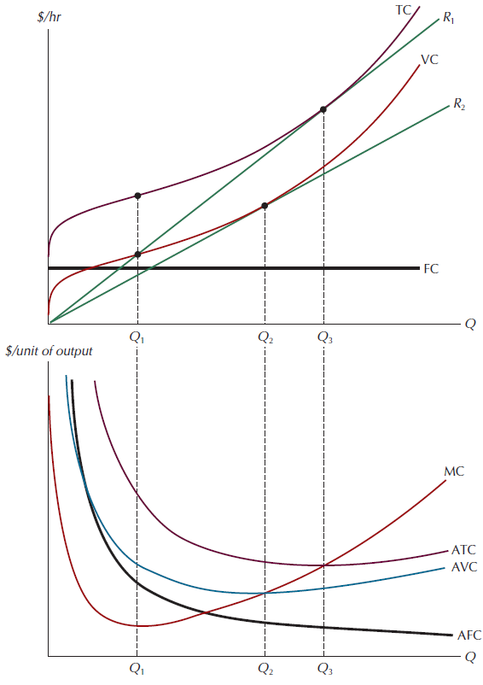
Figure 9.5: The Marginal, Average Total, Average Variable, and Average Fixed Cost Curves

Slide 23
The Marginal, Average Total, Average Variable, and Average Fixed Cost Curves
The slope of the total cost curve decreases with output up to Q₁, and rises with output thereafter.
This tells us that the marginal cost curve, labeled MC in the bottom panel, will be downward sloping up to Q₁ and upward sloping thereafter.
Q₁ is the point at which diminishing returns set in for this production function, and diminishing returns are what account for the upward slope of the short-run marginal cost curve.
At the output level Q₃, the slope of the total cost curve is exactly the same as the slope of the ray to the total cost curve
This tells us that marginal cost and average total cost will take precisely the same value at Q₃.
For output levels in excess of Q3, the slope of the total cost curve is larger than the slope of the corresponding ray, so marginal cost will be larger than average total cost for output levels larger than Q3.

Slide 24
Per Unit Output Cost Curves
$30
28
26
24
22
20
18
16
14
MC
Cost
12
ATC
10
AVC
8
6
4
2
AFC
0
2
4
6
8
10
12
14
16
18
20
22
24
26
28
30
32
Quantity of earrings

Slide 25
Marginal and Average Costs
MC intersects each curve at its minimum point.
When MC is less than average cost (either ATC or AVC), the average cost curve must be decreasing with output; and when MC is greater than average cost, average cost must be increasing with output.

Slide 26
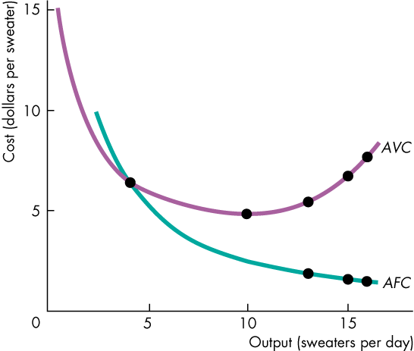
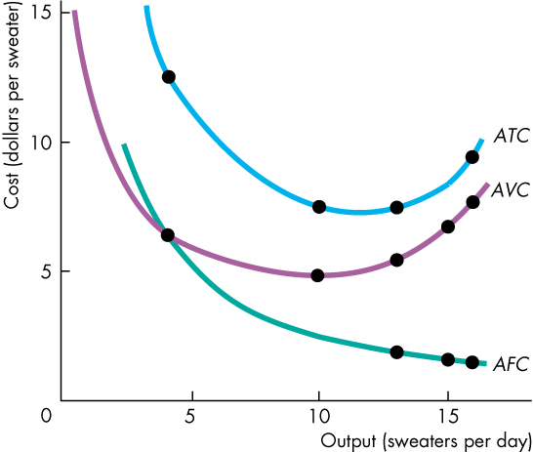
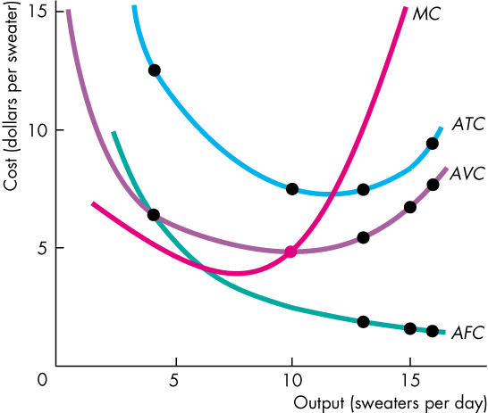
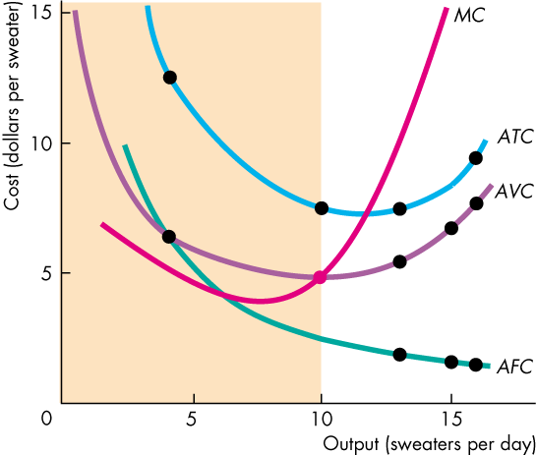
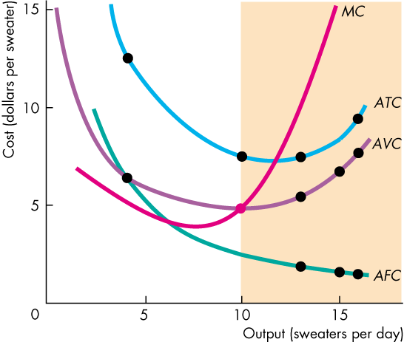
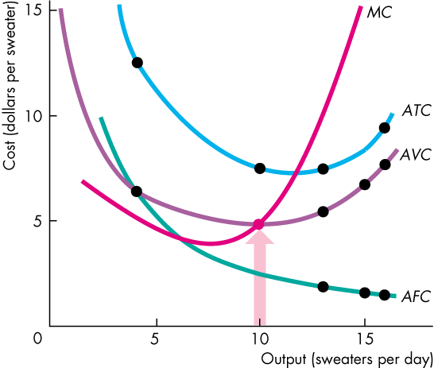
Short-Run Cost
  The ATC curve is also
  U-shaped.
  The MC curve is very special.
  For outputs over which AVC is falling, MC is below AVC.
  For outputs over which AVC is rising, MC is above AVC.
  For the output at minimum AVC, MC equals AVC.

Slide 27
The Relationship Between Productivity and Costs
The shapes of the cost curves are mirror-image reflections of the shapes of the corresponding productivity curves.
When one is increasing, the other is decreasing.
When one is at a maximum, the other is at a minimum.

Slide 28
The Relationship Between Productivity and Costs
$18
9
16
MC
8
14
7
12
AVC
6
A
10
5
Costs per unit
Productivity of workers at this output
8
4
AP of workers
6
3
4
2
2
1
MP of workers
0
4
8
12
16
20
24
Output
0
4
8
12
16
20
24
Output

Slide 29
Relationship Between Marginal and Average Costs
The marginal cost and average cost curves are related.
  When marginal cost exceeds average cost, average cost must be rising.
  When marginal cost is less than average cost, average cost must be falling.
  This relationship explains why marginal cost curves always intersect average cost curves at the minimum of the average cost curve.

Slide 30
Relationship Between Marginal and Average Costs
The position of the marginal cost relative to average total cost tells us whether average total cost is rising or falling.
  To summarize:
  If MC > ATC, then ATC is rising.
  If MC = ATC, then ATC is at its low point.
  If MC < ATC, then ATC is falling.

Slide 31
Relationship Between Marginal and Average Costs
Marginal and average total cost reflect a general relationship that also holds for marginal cost and average variable cost.
  If MC > AVC, then AVC is rising.
  If MC = AVC, then AVC is at its low point.
  If MC < AVC, then AVC is falling.

Slide 32
Relationship Between Marginal and Average Costs
Average total cost will fall when marginal cost is above average variable cost, so long as average variable cost does not rise by more than average fixed cost falls.

Slide 33
Relationship Between Marginal and Average Costs
$90
ATC
80
MC
70
Area A
Area C
60
AVC
Area B
50
ATC
40
AVC
Costs per unit
30
B
20
A
10
MC
Q₀
Q₁
0
1
2
3
4
5
6
7
8
9
Quantity of output

Slide 34
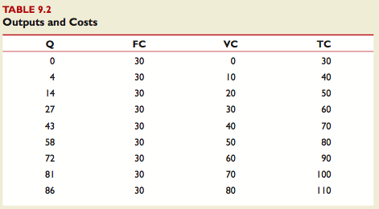
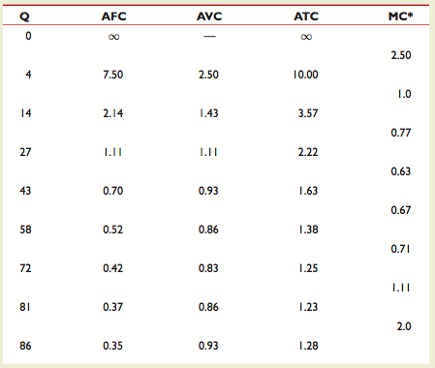
Example 9.2: Production costs

Slide 35




Example:
Suppose output is given by the production function Q = 3KL, where K denotes capital and L denotes labor. The price of capital is $2/machine-hr, the price of labor is $24/person-hr, and capital is fixed at 4 units in the short run.

Slide 36
With K fixed at 4 machine-hr/ hr in the short run and a price of K of r = $2/machine-hr, fixed costs are $8/hr. To produce Q units of output per hour requires Q/12 person-hr/ hr of labor. With a price of labor of $24/person-hr, variable cost is $2Q/hr.
Total cost is $8/hr + $2Q/hr.

Slide 37
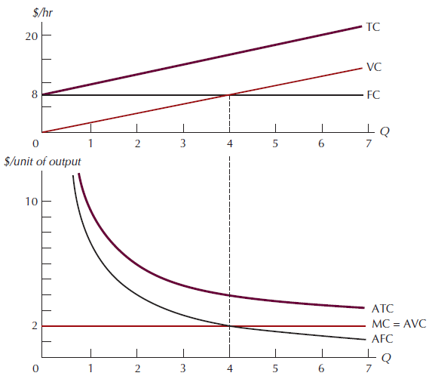
Figure 9.7: Cost Curves for a Specific Production Process

Slide 38

The Relationship Among MP, AP, MC and AVC
MC =
=
=
=
AVC = VC/Q = wL/Q = w/AP

Slide 39
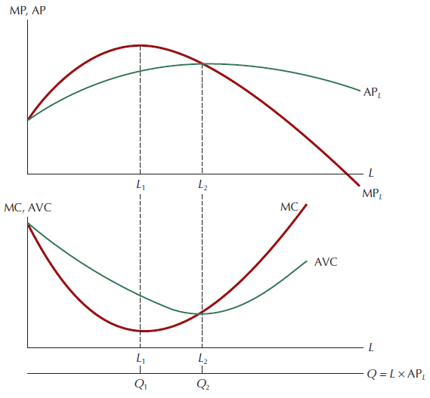
The Relationship Among MP, AP, MC, and AVC
The Relationship among
MP, AP, MC, and AVC
Normally, the MC and AVC
curves are plotted with Q on
the horizontal axis. In the
bottom panel, they are
shown as functions of L. The
value of Q that corresponds
to a given value of L is found
by multiplying L times the
corresponding value of AP_{L}.
The maximum value of the
MP curve, at L = L1, top
panel, corresponds to the
minimum value of the MC
curve, at Q = Q1, bottom
panel. Similarly, the maximum
value of the AP curve, at
L = L2, top panel, corresponds
to the minimum value of the
AVC curve, at Q = Q₂, bottom panel.

Slide 40
COSTS IN THE LONG RUN
In the long run all inputs are variable by definition. If the manager of the firm wishes to produce a given level of output at the lowest possible cost and is free to choose any input combination she pleases, which one should she choose? As we will see in the next section, the answer to this question depends on the relative prices of capital and labor.

Slide 41
CHOOSING THE OPTIMAL INPUT COMBINATION
No matter what the structure of industry may be—monopolistic or atomistically competitive, capitalist or socialist, industrialized or less developed—the objective of most producers is to produce any given level and quality of output at the lowest possible cost. Equivalently, the producer wants to produce as much output as possible from any given expenditure on inputs.

Slide 42
Let us begin with the case of a firm that wants to maximize output from a given level of expenditure. Suppose it uses only two inputs, capital (K) and labor (L), whose prices, measured in dollars per unit of input per day, are r = 2 and w = 4, respectively. What different combinations of inputs can this firm purchase for a total expenditure of C = $200/day?

Slide 43
Isocost line: a set of input bundles each of which costs the same amount.
To find the minimum cost point we begin with a specific isoquant then superimpose a map of isocost lines, each corresponding to a different cost level.
  The least-cost input bundle corresponds to the point of tangency between an isocost line and the specified isoquant.

Slide 44
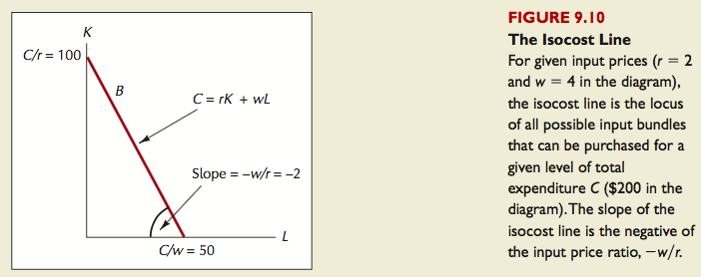
Any of the input combinations on the locus labeled B can be purchased for a total expenditure of $200/day. Analogously to the budget constraint case, the slope of the isocost line is the negative of the ratio of the input prices, -w/r.

Slide 45
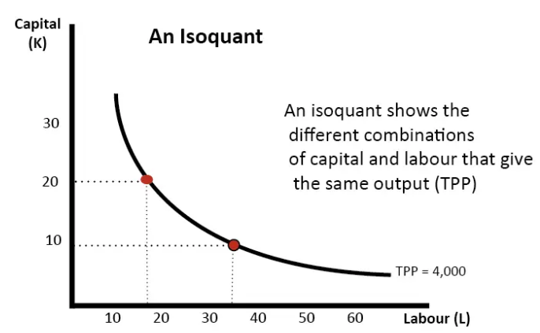
An isoquant shows all the combination of two factors that produce a given output. An isoquant is usually shaped concave because of the law of diminishing returns. With fixed capital employing extra workers gives a declining increase in the marginal product (MP)

Slide 46
In this diagram, the isoquant shows all the combinations of labor and capital that can produce a total output (Total Physical Product TPP) of 4,000.
In the above isoquant, this could be 20 capital and 18 labor or (more capital intensive), 9 capital and 35 labor. (more labor intensive)

Slide 47
The analytic approach for finding the maximum output that can be produced for a given cost turns out to be similar to the one for finding the optimal consumption bundle. Just as a given level of satisfaction can be achieved by any of a multitude of possible consumption bundles (all of which lie on the same indifference curve), so too can a given amount of output be produced by any of a host of different input combinations (all of which lie on the same isoquant). In the consumer case, we found the optimum bundle by superimposing the budget constraint onto the indifference map and locating the relevant point of tangency. Here, we superimpose the isocost line onto the isoquant map. In Figure 9.11, the tangency point (L*, K*) is the input combination that yields the highest possible output (Q₀) for an expenditure of C.

Slide 48
As noted, the problem of producing the largest output for a given expenditure is solved in essentially the same way as the problem of producing a given level of output for the lowest possible cost. The only difference is that in the latter case we begin with a specific isoquant, then superimpose a map of isocost lines, each corresponding to a different cost level. In our first exercise, cost was fixed and output varied; this time, output is fixed and costs vary. As shown in Figure 9.12, the least-cost input bundle (L*, K*) corresponds to the point of tangency between an isocost line and the specified isoquant (Q₀).

Slide 49
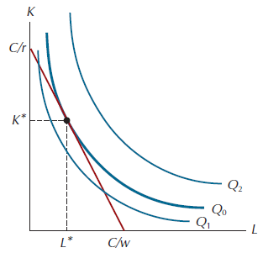
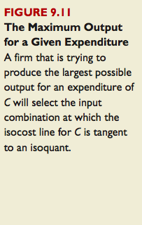
The Maximum Output for a Given Expenditure

Slide 50
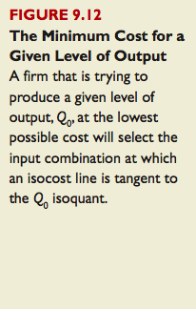
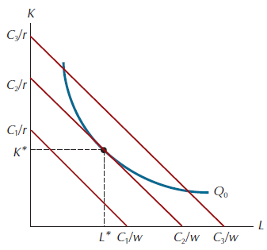
The Minimum Cost for a Given Level of Output

Slide 51


Recall from Chapter 8 that the slope of the isoquant at any point is equal to –MP_{L}/MP_{K}, the negative of the ratio of the marginal product of L to the marginal product of K at that point. (Recall also from Chapter 8 that the absolute value of this ratio is called the marginal rate of technical substitution.) Combining this with the result that minimum cost occurs at a point of tangency with the isocost line (whose slope is –w/r), it follows that
where K* and L* again denote the minimum-cost values of K and L. Cross- multiplying, we have

Slide 52

Note first that MPL* is simply the extra output obtained from an extra unit of L at the cost-minimizing point. w is the cost, in dollars, of an extra unit of L. The ratio MPL*/w is thus the extra output we get from the last dollar spent on L. Similarly, MPK*/r is the extra output we get from the last dollar spent on K. In words, Equation 9.21 tells us that when costs are at a minimum, the extra output we get from the last dollar spent on an input must be the same for all inputs. More generally, we may consider a production process that employs not two but N inputs, X₁, X₂, . . . , X_{N}. In this case, the condition for production at minimum cost is a straightforward generalization of Equation 9.21:

Slide 53
The Relationship Between Optimal Input Choice and Long-Run Costs
Given sufficient time to adjust, the firm can always buy the cost-minimizing input bundle that corresponds to any particular output level and relative input prices. To see how the firm’s costs vary with output in the long run, we need only compare the costs of the respective optimal input bundles. The curve labeled EE in Figure 9.15 shows the firm’s output expansion path.
output expansion path: the locus of tangencies (minimum cost input combinations) traced out by an isocost line of given slope as it shifts outward into the isoquant map for a production process.

Slide 54
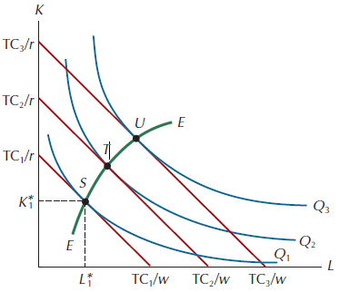
It is the set of cost-minimizing input bundles when the input price ratio is fixed at w/r. Thus, when the price of K is r and the price of L is w, the cheapest way to produce Q₁ units of output is to use the input bundle S, which contains K*₁ units of K, L*₁ units of L, and costs TC₁. The bundle S is therefore one point on the output expansion path. In like fashion, the output level Q₂ is associated with bundle T, which has a total cost of TC₂; Q₃ is associated with U, which costs TC₃; and so on. In the theory of firm behavior, the long-run expansion path is the analog to the income-consumption curve in the theory of the consumer.

Slide 55
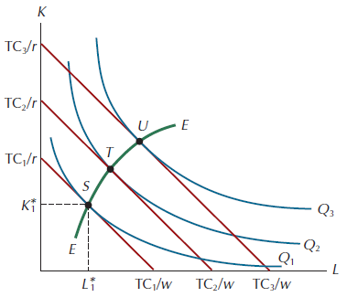
The Long-Run
Expansion Path

Slide 56
To go from the long-run expansion path to the long-run total cost curve, we simply plot the relevant quantity-cost pairs from Figure 9.15. Thus, the output level Q₁ corresponds to a long-run total cost of TC₁, Q₂ to TC₂, and so on. The result is the curve labeled LTC in the top panel in Figure 9.16.
In the long run there is no need to distinguish among total, fixed, and variable costs, since all costs are variable.

Slide 57
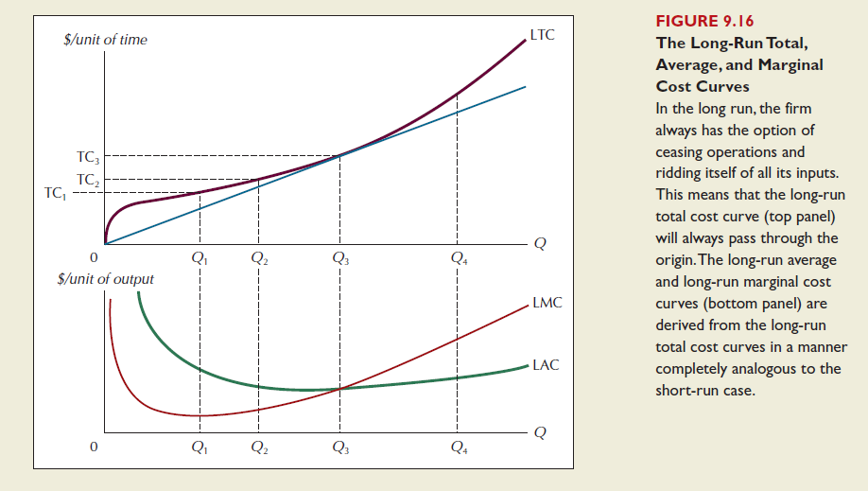

Slide 58
Changes in Output
A change in output moves the isoquant constraint outwards.
Definition: An expansion path is the line that connects the cost-minimising input combinations as output varies, holding input prices constant

Slide 59
K
Example: Expansion Path with Normal Inputs
TC₀/r
•
Q₀
L
TC₀/w

Slide 60
K
Example: Expansion Path with Normal Inputs
TC₁/r
TC₀/r
•
•
Q₁
Q₀
L
TC₀/w TC₁/w

Slide 61
K
Example: Expansion Path with Normal Inputs
TC₂/r
TC₁/r
•
TC₀/r
•
Q₂
•
Q₁
Q₀
L
TC₀/w TC₁/w TC₂/w

Slide 62
K
Example: Expansion Path with Normal Inputs
TC₂/r
TC₁/r
Expansion path
•
TC₀/r
•
Q₂
•
Q₁
Q₀
L
TC₀/w TC₁/w TC₂/w

Slide 63
Changes in Output
As output increases, the quantity of input used may increase or decrease
Definitions:
If the cost-minimising quantities of labour and capital rise as output rises, labour and capital are normal inputs
If the cost-minimising quantity of an input decreases as the firm produces more output, the input is an inferior input

Slide 64
K
Example: Labour as an Inferior Input
TC₀/r
•
Q₀
L
TC₀/w

Slide 65
K
Example: Labour as an Inferior Input
TC₁/r
•
TC₀/r
•
Q₁
Q₀
L
TC₀/w TC₁/w

Slide 66
K
Example: Labour as an Inferior Input
Expansion path
TC₁/r
•
TC₀/r
•
Q₁
Q₀
L
TC₀/w TC₁/w

Slide 67
Costs in Short Run and in Long Run
Many decisions
  Fixed in the short run
  Variable in the long run,
Firms – greater flexibility in the long-run
  Long-run cost curves
    Differ from short-run cost curves
    Much flatter than short-run cost curves
  Short-run cost curves
    Lie on or above the long-run cost curves

Slide 68
LONG-RUN COSTS AND THE STRUCTURE OF INDUSTRY
Long-run costs are important because of their effect on the structure of industry. When, as in Figure 9.20a, there are declining long-run average costs throughout, the tendency will be for a single firm to serve the market. If two firms attempted to serve such a market, with each producing only part of the total output sold, each would have higher average costs than if one of them alone served the market. The tendency in such a market will be for the firm that happens to grow larger to have a cost advantage that enables it to eliminate its rival. Markets characterized by declining long-run average cost curves are for this reason often referred to as natural monopolies.

Slide 69
natural monopoly an industry whose market output is produced at the lowest cost when production is concentrated in the hands of a single firm.

Slide 70
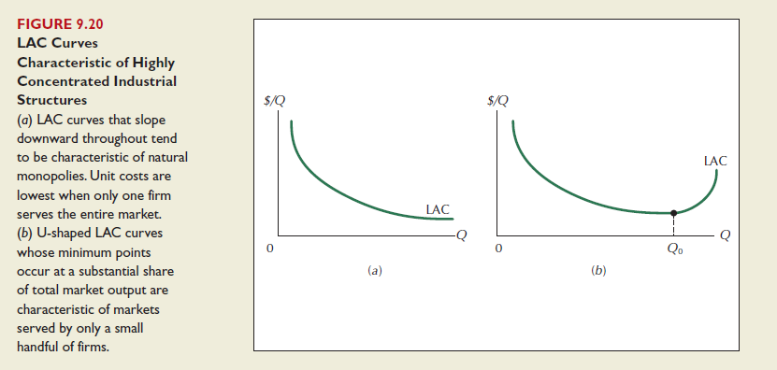

Slide 71
Consider now the LAC curve shown in Figure 9.20b. The minimum point on this curve occurs at the output level Q₀. At that output level, the firm achieves its lowest possible unit cost of production. The output level Q₀ may be called the minimum efficient scale: the level of production required for LAC to reach its minimum level. If Q₀ constitutes a substantial share of industry output— more than, say, 20 percent—the industry will tend to be dominated by a small handful of firms. As in the natural monopoly case, a large number of small firms would be unlikely to survive in such a market, since each would have much higher average costs than larger firms. By contrast to the natural monopoly case, however, the upturn in the LAC beyond Q₀ will make it difficult for a single firm to serve the entire market. Markets served by firms with LACs like the one in Figure 9.20b are likely to be “highly concentrated,” which means that a small number of firms will tend to account for the lion’s share of all output sold.

Slide 72
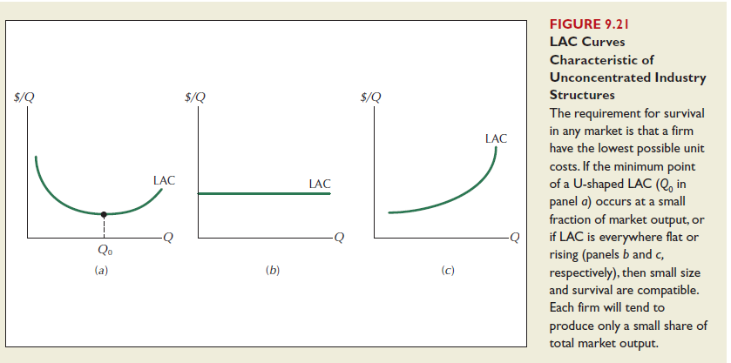
The long-run average cost curve associated with a market served by many firms is likely to take one of the three forms shown in Figure 9.21.

Slide 73
If Q₀, the minimum point on the U-shaped average cost curve in panel a, constitutes only a small fraction of total industry output, we expect to see an industry populated by numerous firms, each of which produces only a small percentage of total industry output. Small size is also not a disadvantage when the production process is one that gives rise to a horizontal LAC curve like the one shown in panel b. For such processes, all firms—large or small—have the same unit costs of production. For the upward-sloping LAC curve shown in panel c in Figure 9.21, small size is not only compatible with survival in the marketplace but positively required, since large firms will always have higher average costs than smaller ones. As a practical matter, however, it is very unlikely that there could ever be an LAC curve that is upward sloping even at extremely small levels of output. (Imagine, for example, the unit costs of a firm that tried to produce 1/100 of a
pound of sugar.)

Slide 74
The relationship between market structure and the shape of the long-run average cost curve derives from the fact that, in the face of competition, market survival requires firms to have the lowest unit costs possible under existing production technology. Whether that happens at low or high levels of output depends entirely on the shape of the LAC curve.

Slide 75
A Typical LRATC Curve
In the real world, factories come in many sizes,
each with its own SRATC curve. So a typical LRATC curve
looks like this:
ATC
LRATC
Q
Notes:
75

Slide 76
Average total cost in the short and long runs
Average
Total
Cost
ATC in short
run with
small factory
ATC in short
run with
medium factory
ATC in short
run with
large factory
ATC in long run
$12,000
10,000
Economies
of scale
Diseconomies
of scale
Constant returns to scale
0
1,000
1,200
Quantity of Cars per Day
Because fixed costs are variable in the long run, the average-total-cost curve in the short run differs from the average-total-cost curve in the long run.

Slide 77
How ATC Changes as the Scale of Production Changes
Economies of scale: ATC falls
as Q increases.
Constant returns to scale: ATC stays the same
as Q increases.
Diseconomies of scale: ATC rises
as Q increases.
ATC
LRATC
Q
Notes:
77

Slide 78
Economies of scale
  Long-run average total cost falls as the quantity of output increases
  Increasing specialization
  Constant returns to scale
  Long-run average total cost stays the same as the quantity of output changes
  Diseconomies of scale
  Long-run average total cost rises as the quantity of output increases
  Increasing coordination problems

Slide 79
The many types of cost: A summary
Term | Definition | Mathematical Description
Explicit costs Implicit costs Fixed costs Variable costs Total cost Average fixed cost Average variable cost Average total cost Marginal cost | Costs that require an outlay of money by the firm Costs that do not require an outlay of money by the firm Costs that do not vary with the quantity of output produced Costs that vary with the quantity of output produced The market value of all the inputs that a firm uses in production Fixed cost divided by the quantity of output Variable cost divided by the quantity of output Total cost divided by the quantity of output The increase in total cost that arises from an extra unit of production | FC VC TC = FC + VC AFC = FC / Q AVC = VC / Q ATC = TC / Q MC = ΔTC / ΔQ

