Slide 1
ECON 575 FUNDAMENTALS OF ECONOMICS CHAPTER 9 NATIONAL INCOME ACCOUNTING Prof. Dr. Dilek TEMİZ DİNÇ

Slide 2
What Is Macroeconomics?
Macroeconomics is the study of the behavior of the economy as a whole and the policy measures that the government uses to influence it. Utilizes measures including total output, rates of unemployment and inflation, and exchange rates….

Slide 3
Macroeconomics: aggregates individual markets → look at markets as a whole
AD and AS
Issues include unemployment, economic growth
Microeconomics: examines behavior of individual economic units (households, firms)
Issues include product and input price determination

Slide 4
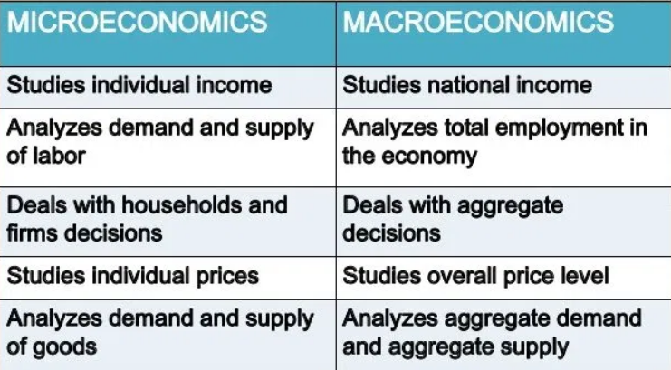

Slide 5
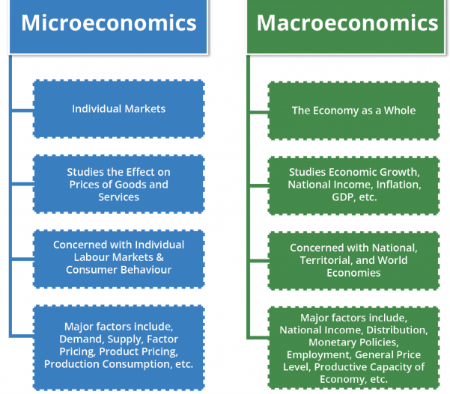

Slide 6
National Income accountıng
Why do we study the national income accounts?
National income accounting provides formal structure for macro theory models
Introduces statistics that characterize the economy
Output defined in two ways
Production side: output = payments to workers (wages), capital (interest and dividends)
Demand side: output = purchases by different sectors of the economy
Output typically measured as GDP = value of all final goods and services produced within a country over a particular period of time

Slide 7
Production Side of the Economy
The production side of the economy transforms inputs (labor, capital) into output (GDP)
Inputs = factors of production
Payments to these factors = factor payments
The relationship between inputs and outputs defined by the production function →
where Y = output, N = labor, K = capital
“Output is a function of labor and capital,” where the functional form can be defined in various ways
For example: corn = f (land, labor, seed, machines)

Slide 8
From GDP to Factor Payments
We use the terms output and income interchangeably in macroeconomics → are they really equivalent?
There are a few crucial distinctions between them:
Capital wears down over time while it is being used in the production process → Net domestic product = GDP – depreciation
NDP is the total value of production minus the value of the amount of capital used up in producing that output
NDP is usually 87-89% of GDP

Slide 9
From GDP to Factor Payments
We use the terms output and income interchangeably in macroeconomics → are they really equivalent?
There are a few crucial distinctions between them:
2. Businesses pay indirect taxes (i.e. taxes on sales, property, and production) that must be subtracted from NDP before making factor payments → Factor payments = NDP – indirect business taxes

Slide 10
Components of Demand
Total demand for domestic output is made up of four components:
Consumption spending by households (C)
Investment spending by firms (I)
Government spending (G)
Foreign demand for our net exports (NX)
The fundamental national income accounting identity is
(3)

Slide 11
Consumption
Consumption refers to the purchases of goods and services by the household sector
Includes spending on durable (ex. Cars), non-durable (ex. Food), and services (ex. Medical services)
Consumption is the primary component of demand

Slide 12
Government
Government purchases of goods and services include national defense expenditures and salaries of government employees
Government also makes transfer payments = payments made to people without their providing a current service in exchange
Ex. Social security, unemployment benefits
Transfer payments are NOT included in GDP since not a part of current production
Government expenditure = transfers + purchases

Slide 13
Investment
Investment = additions to the physical stock of capital (i.e. building machinery, construction of factories, additions to firms inventories)
In the national income accounts, investment associated with business sector’s adding to the physical stock of capital, including inventories
Household’s building up of inventories is considered consumption, although new home constructions considered part of I, not C
Gross investment included in GDP measure, which is net investment plus depreciation

Slide 14
Net Exports
Accounts for domestic purchases of foreign goods (imports) and foreign purchases of domestic goods (exports) → NX = Exports – Imports
Subtract imports from GDP since accounting for total demand for domestic production
NX can be >, <, or = 0

Slide 15
Some Identities: A Simple Economy
Assume national income equals GDP → use terms income and output interchangeably (convenience)
Begin with a simple economy: closed economy with no public sector → output expressed as (4)
Only two things can do with income: consume and save → national income expressed as (5), where S is private savings
Combine (4) and (5): (6)
Rearrange (6) s.t. (7),
or investment = savings in the simple economy

Slide 16
Some Identities: Adding G and NX
When adding the government and the foreign sector, the fundamental identity becomes
(8) (Expenditure approach)
Disposable income, YD, is what consumers split between C and S when have a public sector, or
(9)
where TR = transfer payments and TA = taxes → (10)
If rearrange (9) and substitute (8) for Y, then
(11)
Substituting (10) into (11): (12)

Slide 17
Some Identities: Adding G and NX
When adding the government and the foreign sector, the fundamental identity becomes (8)
Disposable income, YD, is what consumers split between C and S when have a public sector, or
(9), where TR = transfer payments and TA = taxes → (10)
If rearrange (9) and substitute (8) for Y, then
(11)
Substituting (10) into (11): (12)
Rearranging: (13)

Slide 18
S, I, Government Budget, and Trade
where G + TR is total government expenditures and TA is government income → difference between expenditures and income is the government budget deficit

Slide 19
S, I, Government Budget, and Trade
Excess of savings over investment (S > I) in the private sector is equal to the government budget deficit plus the trade surplus
Any sector that spends more than it receives in income has to borrow to pay for the excess spending
Private sector can dispose of savings in three ways:
Make loans to the government
Private sector can lend to foreigners
Private sector can lend to firms who use the funds for I

Slide 20
Measuring Gross Domestic Product
GDP = value of final goods and services currently produced within a country over a period of time
Final goods and services → NO DOUBLE COUNTING
Ex. Would not include the full price of a car AND the tires bought by the manufacturer for the car → tires = intermediate goods

Slide 21
Measuring Gross Domestic Product
GDP = value of final goods and services currently produced within a country over a period of time
Goods and services currently (in the time period being considered) produced & excludes transactions involving used goods
Ex. Include the construction of new homes in current GDP, but not the sale of existing homes

Slide 22
Measuring Gross Domestic Product
GDP = value of final goods and services currently produced within a country over a period of time
Goods and services produced within a country, regardless of the ownership/nationality of the producing firm
Ex. Include the sale of a car produced by a Japanese car manufacturer located in Turkey in Turkey‘s GDP

Slide 23
The Factor Income Approach
It consists of employee compensation (wage), rent, interest, and profits.
When we add indirect taxes (less subsidies) and depreciation to nations income, we have GDP.
GDP = w + r + i + ∏ + indirect (business) taxes+ depreciation - subsidies

Slide 24
Equality of Expenditure and Income
Net foreign factor income
Depreciation
Net exports
Indirect taxes-subsidies
Government expenditures
Inventory adjustment
Farm income
Investment
Interest and investment income
GNP
GDP
Profits before taxes
National Income
Consumption
Wages and salaries
(1)
Expenditures
=
(2)
Output
=
(3)
Income

Slide 25
Other National Income Terms
Personal income (PI) is national income plus net transfer payments from government minus amounts attributed but not received.
PI = NI + transfer payments from government - corporate retained earnings - corporate income taxes – employment taxes

Slide 26
Other National Income Terms
Disposable personal income is personal income minus personal income taxes and payroll taxes.
Disposable personal income is what people have readily available to spend.
DPI = PI - personal taxes

Slide 27
Problems of GDP Measurement
There are three major criticisms of the GDP measure:
Omits non-market goods and services
Ex. Work of stay-at-home mothers and fathers not included in GDP
No accounting for “bads” such as crime and pollution
Ex. Crime is a detriment to society, but there is no subtraction from GDP to account for it
No correction for quality improvements
Ex. Technological improvements are beneficial to the economy, but nothing is added to GDP to account for them
→ Despite these drawbacks, GDP is still considered one of the best economic indicators for estimating growth in an economy

Slide 28
Nominal vs. Real GDP
NGDP is the value of output in a given period measured in current dollars
NGDP in 2020 is the sum of the value of all outputs measured in 2020 dollars:
Changes in NGDP could be purely due to changes in prices → if GDP is to be used as a measure of output, need to control for prices

Slide 29
Nominal vs. Real GDP
RGDP is the value of output in constant dollars → scaled by a based year price, so that any change in GDP is due to change in production, not prices
If P^{B} is the price in the base year for good i, RGDP in 2020 is:
vs.

Slide 30
Inflation and Prices
Inflation, Π, is the rate of change of prices:
where P_{t} is today’s price and P_{t-1} is last period’s price
Additionally, or today’s price
equals last year’s price, adjusted for inflation
If Π > 0, prices are increasing over time → inflation
If Π < 0, prices are decreasing over time → deflation
How do we measure prices?
For the macroeconomy, need a measure of overall prices (price index)
Most common indexes are CPI, PPI, and the GDP deflator

Slide 31
Price Indexes: GDP Deflator
GDP deflator is the ratio of NGDP in a given year to RGDP of that year
Since GDP deflator is based on a calculation involving all goods produced in the economy, it is a widely based price index that is frequently used to measure inflation
Measures the change in prices between the base year and the current year
Ex. If NGDP in 2012 is $6.25 and RGDP in 2012 is $3.50, then the GDP deflator for 2012 is $6.25/$3.50 = 1.79 → prices have increased by 79% since the base year

Slide 32
Price Indexes: CPI
CPI measures the cost of buying a fixed basket of goods and services representative of the purchases of urban consumers
Measure of the cost of living for the average household
Differs from GDP deflator in three ways:
CPI measures prices of a more limited basket of goods and services (only household goods and services)
The bundle of goods in the consumer basket is fixed, while that of the deflation is allowed to vary
CPI includes prices of imports, while GDP deflator only considers those goods produced within the Turkey.

Slide 33
Price Indexes: PPI
PPI measures the cost of buying a fixed basket of goods and services representative of a firm
Captures the cost of production for a typical firm
Market basket includes raw materials and semi-finished goods
PPI is constructed from prices at an earlier stage of the distribution process than the CPI
PPI signals changes to come in the CPI and is thus closely watched by policymakers
→ Over long periods of time, the two measures yield similar values and trends for inflation

Slide 34
Unemployment
The unemployment rate measures the fraction of the workforce that is out of work and looking for a job or expecting a recall from a layoff
Important indicator of well-being of an economy/households
Optimal unemployment rates differ from country to country
Optimal unemployment rate linked to the potential level of output for a given economy.

Slide 35
Interest Rates and Real Interest Rates
Interest rate = rate of payment on a loan or other investment over and above the principle repayment in terms of an annual percentage
Cost of borrowing money OR benefit of lending money
Nominal interest rate = return on an investment in current dollars
Real interest rate = return on an investment, adjusted for inflation
If R is the nominal rate, and r is the real rate, then we can define the nominal rate as:

Slide 36
Exchange Rate
Each country has its own currency in which prices are quoted
In the U.S. prices are quoted in U.S. dollars, while in Canada prices are quoted in Canadian dollars and most of Europe uses the euro
Exchange rate = the price of a foreign currency
Floating exchange rate → price of a currency is determined by supply and demand
Fixed exchange rate → price of a currency is fixed
Ex. A Bermuda dollar is always worth one U.S. dollar

